Slide 1


Slide 2

Abortion and Mental Health: Well-established adverse outcomes & An examination of women At THE HIGHEST RISK
International Institute for
Reproductive Loss
Priscilla K. Coleman, PhD
Notes:
NOTE:
To change the image on this slide, select the picture and delete it. Then click the Pictures icon in the placeholder to insert your own image.

Slide 3

Abortion Increases Risk for Mental Health Problems
The number of peer-reviewed studies identifying negative mental health outcomes associated with abortion has increased dramatically in recent years.
Hundreds of studies have shown women who choose abortion, compared to those who carry to term, experience an increased risk of mental health problems, including substance abuse, anxiety, depression, suicidal ideation, and suicide, among other conditions and symptoms

Slide 4
Negative Post-Abortion Emotions
Abortion evokes powerful negative emotions in countless women. This is reflected in “A Clinician’s Guide to Medical and Surgical Abortion” (Paul, et al., 1999). The chapter on counseling explains women may experience the following after an abortion:
Depression: crying, suicidal ideation, poor performance in school or work, loss of interest in activities, and feelings of worthlessness.
Severe guilt: self-punishing behaviors, such as substance abuse or indiscriminate sexual activity, nightmares about killing or saving babies, blocking out the experience, avoiding anything that triggers memories of the event, fearing God’s punishment, and interpreting misfortune, illness, or accident as signs of God’s punishment.
Shame: relentless thoughts of being a bad person, engaging in self-destructive behaviors, and fear of anyone finding out about the abortion.
Unresolved grief: engaging in thoughts and behaviors that perpetuate a strong emotional investment in the pregnancy or that prevent the redirection of emotional energy into moving forward with life.

Slide 5
Negative Post-Abortion Emotions
Fergusson and colleagues (2009), reported high percentages of women responded “somewhat” or “very much” to experiencing these negative emotions:
- Sorrow 68.3%
- Sadness 71.1%
- Guilt 63.5%
- Regret 32.7%
- Grief 48.1%
- Disappointment 61.5%
The number of negative post-abortion responses predicted subsequent mental health disorders.
Norwegian researches, Røseth and colleagues (2022), identified four central post-abortion psychological themes:
1) A “logical and sensible” choice with doubt beneath the surface.
2) Secrecy and shame.
3) Emotional distancing as a coping strategy.
4) Moving on and revisiting the meaning of the abortion.
Their results underscored the emotional complexity of women’s post-abortion adjustment.

Slide 6

Rigorous Science
The scientific evidence linking abortion to mental health problems is published in leading peer-reviewed journals in psychology and medicine.
There are now dozens of large-scale prospective studies with 1000s of participants incorporating comparison groups and other control techniques, fortifying the level of confidence in the results.
Studies have implemented controls for potentially confounding variables, including prior mental health issues, reproductive history, experience of abuse of various forms, and several demographic variables.
With controls, the reliability and validity of the findings are enhanced as teasing out the independent contribution of abortion to mental health challenges is facilitated.

Slide 7
Recently Published Large Scale Research Studies on the Association between Abortion and Mental Health
STUDY | RESULTS
Gong, X., Hao, J., Tao, F., Zhang, J., Wang, H., & Xu, R. (2013). Pregnancy loss and anxiety and depression during subsequent pregnancies: Data from the C-ABC study. European Journal of Obstetrics, Gynecology, and Reproductive Biology, 166(1), 30–36. | Large Chinese study (over 20,000 women), 7,683 of whom had an abortion. Abortion was related to increased risk of depression (OR: 1.381) and anxiety (OR: 1.211) in the first trimester of a later pregnancy after controlling for age, education, pre-pregnancy MBI, income, and residence. The comparison group was women experiencing a first pregnancy.
Gissler, M., Karalis, E., & Ulander, V.M. (2015). Decreased suicide rate after induced abortion, after the Current Care Guidelines in Finland 1987-2012. Scand J Public Health, 43(1), 99-101. | Examined suicide post-abortion between 1987 and 2012 in Finland. A 2-fold increased risk of suicide was observed even after new guidelines required post-abortion follow-up sessions at 2-3 weeks to monitor women’s mental health.

Slide 8
Recently Published Large Scale Research Studies on the Association between Abortion and Mental Health
STUDY | RESULTS
Jacob, L., Gerhard, C., Kostev, K., & Kalder, M. (2019). Association between induced abortion, spontaneous abortion, and infertility respectively and the risk of psychiatric disorders in 57,770 women followed in gynecological practices in Germany. Journal of Affective Disorders, 251, 107–113. | Case-control study from the Disease Analyzer Database (IQVIA). Induced abortion was positively associated with the elevated risk of psychiatric disorders (ORs ranging from 1.75 to 2.01).
Jacob, L., Kostev, K., Gerhard, C., & Kalder, M. (2019). Relationship between induced abortion and the incidence of depression, anxiety disorder, adjustment disorder, and somatoform disorder in Germany. Journal of Psychiatric Research, 114, 75–79. | Examined women with a first abortion in 281 gynecological practices in Germany. Included 17,581 women with an abortion experience and 17,581 matched controls who had a live birth. Induced abortion predicted depression (HR=1.34), adjustment disorder (HR=1.45), and somatoform disorder (HR=1.56) across the 10-year study period.

Slide 9
Recently Published Large Scale Research Studies on the Association between Abortion and Mental Health
STUDY | RESULTS
Lega, I., Maraschini, A., D’Aloja, P., et al., & Regional Maternal Mortality Working Group (2020). Maternal suicide in Italy. Archives of Women's Mental Health, 23(2), 199–206. | Data were gathered from 10 regions in Italy. The suicide rate was 1.18 per 100,000 among women who gave birth (n = 2,876,193) and 2.77 among women who aborted (n = 650,549), a statistically significant difference.
Luo, M., Jiang, X., Wang, Y., Wang, Z., Shen, Q., Li, R., & Cai, Y. (2018). Association between induced abortion and suicidal ideation among unmarried female migrant workers in three metropolitan cities in China: A cross-sectional study. BMC Public Health, 18(1), 625. | In a sample of 5,115, abortion was associated with nearly double the odds of suicidal ideation after adjustment for numerous controls. The association was strongest in those aged > 25 (OR = 3.37), among women with > 5 years in the work force (OR = 2.98), in the non-anxiety group (OR = 2.28), and in the non-depression group (OR = 2.94).

Slide 10
Recently Published Large Scale Research Studies on the Association between Abortion and Mental Health
STUDY | RESULTS
McCarthy, F. P., Moss-Morris, R., Khashan, A. S., et al. (2015). Previous pregnancy loss has an adverse impact on distress and behaviour in subsequent pregnancy. BJOG: An International Journal of Obstetrics and Gynaecology, 122(13), 1757–1764. | Pregnant women with one prior abortion had elevated stress (adjusted mean difference=0.65) and depression (aOR=1.25) at 15 weeks of gestation. Women with two prior abortions had increased perceived stress (adjusted mean difference=1.43) and depression (aOR=1.67).
Sullins D. P. (2016). Abortion, substance abuse and mental health in early adulthood: Thirteen-year longitudinal evidence from the United States. SAGE Open Medicine, 4. | U.S. sample, with extensive controls. Abortion was associated with increased overall risk of mental health disorders (OR:1.45). Population Attributable Risk analysis showed 8.7% of the prevalence of mental disorders was attributable to abortion.
Wie, J. H., Nam, S. K., Ko, H. S., et al. (2019). The association between abortion experience and postmenopausal suicidal ideation and mental health: Results from the 5th Korean National Health and Nutrition Examination Survey (KNHANES V). Taiwanese Journal of Obstetrics & Gynecology, 58(1), 153–158. | After adjusting for controls, women who had three abortions had elevated risk for suicidal ideation (OR: 1.510). This level of risk was significant even after controlling for depression (OR: 1.391). Risk of depressive mood in daily life was likewise elevated with more abortions even after controlling for depression (OR: 1.657).

Slide 11

Abortion and Mental Health Literature Reviews
In a 2013 review of 30 studies, Italian researchers Bellieni and Buonocore concluded abortion is a risk factor for mental illness.
Udzma and Achadi (2019) published an analysis of studies examining factors related to depression in pregnancy, and they reported that a maternal history of abortion was a significant factor in four out of the six studies examined.

Slide 12

Chemical Abortion: Risks for psychological injury are even higher than with surgical

Slide 13
Chemical Abortions are the
Dominant Method
U.S. abortion rates have steadily declined for decades (https://www.pewresearch.org), yet the rate of chemical abortions continues to rise, constituting 54% of all abortions (https://www.guttmacher.org/article/2022/02/medication-abortion-now-accounts-more-half-all-us-abortions ).
Chemical abortion has been transitioning to a home-based protocol with limited clinician assistance. This shift occurred without adequate examination of women’s perceptions and personal experiences and largely divorced from women’s individual lives.

Slide 14

Reasons Women Cite for Choosing Chemical over Surgical Abortion
Belief it is safer, “more natural”...akin to menstruation.
No surgery and/or anesthesia.
One or both drugs may be taken at home.
Belief that it is easier and simpler.
Feeling of being more in control.
Increased privacy.

Slide 15

Lowenstein and colleagues (2006) found that compared to women choosing surgical abortion, those choosing chemical abortion were more fragile psychologically:
Higher obsessive-compulsive symptoms.
Higher levels of guilt.
Higher interpersonal sensitivity scores.
More paranoid ideation.
More general psychiatric symptoms.

Slide 16

Reasons to Expect More Psychological Trauma with Chemical Abortion
Compared to Surgical
1. The participatory role of the woman: The woman is directly responsible for the abortion, and this may exacerbate guilt and other negative self- directed thoughts and feelings.

Slide 17

Reasons to Expect More Psychological Trauma with Chemical Abortion
Compared to Surgical
2. Chemical abortion requires the woman to be more alert and involved during the process, making it impossible for her to distance psychologically from what is happening.

Slide 18

Reasons to Expect More Psychological Trauma with Chemical Abortion Compared to Surgical
3. The woman may see the expelled fetus. As a participant in a study by Hallden and colleagues (2008) explained, “You really take your child’s life. I think if you see it then you see that you really do take the life of your child”

Slide 19

Reasons to Expect More Psychological Trauma with Chemical Abortion Compared to Surgical
4. The woman is more likely alone and without emotional support.

Slide 20

Reasons to Expect More Psychological Trauma with Chemical Abortion
Compared to Surgical
5. The home generally or the bathroom in particular may become associated with the abortion. One’s home may become a trigger for uncomfortable emotions as opposed to a refuge.

Slide 21
As researchers Slade and colleagues (1998) noted:
“One of the main differences between these two methods of termination is the consciousness and participation of the patient in the medical procedure in a process that involves blood, pain, and death.”

Slide 22
Rafferty and Longbons (2020) reported that negative and difficult emotions following chemical abortion were common, with 38% explicitly stating problems with anxiety, depression, drug abuse, and suicidal thoughts. For example, one woman said, “I am haunted by the image of my tiny baby. I always will be. I cut myself and even wanted to die.”
Another woman recounted, “Looking at my kids thinking of another beautiful child. Couldn’t live with myself. Wishing God would take my life”
Regret was common in this sample as well, with 77% explicitly stating that they regretted their decision to have an abortion. One woman stated, “Had I known how badly I would feel now, I would have kept the baby, even if I had to go through it alone”

Slide 23
Rafferty and Longbons aptly commented on two women’s experiences.
“They all tell you ‘it’s your choice’ in the moment, but you don’t feel that it is. Being unable to afford it, unable to tell your loved ones, not having the help or feeling unable to support a child. When your partner doesn’t want it like you do. All these things push you, blind you to a decision that you don’t realize will destroy you.”
“I was kind of excited, but I was so scared to tell my family …. I told my mom, and her first response was I hope you’re getting an abortion. You’re going to be a terrible mom.”

Slide 24
Aamlid, and colleagues (2021) concluded that women felt information provided for chemical abortion was inadequate, especially as related to bleeding and pain. One participant commented, “They told me the pain would be like menstrual pain, just a bit more intense. But that was wrong! It was SO much more like childbirth. I’ve given birth twice, so I know. It was really painful! I think the information about pain was misleading. I understand that they don’t want to frighten people, but I really think they should tell you how painful it really is.”
Participants voiced a preference for a follow-up consultation at the hospital instead of a home pregnancy test and wanted both a physical examination and a mental health consultation. The researchers noted, “Based on previous research and the findings of this study, women who are most affected by the situation should either be offered more than one follow-up consultation or be referred to other qualified health care professionals. Women should also receive information about common psychological responses to abortion.”

Slide 25

Studies Indicating More Psychological Distress among Women Undergoing Chemical vs. Surgical Abortion

Slide 26
Slade and colleagues (1998) found that compared to those who had surgical abortions, those who had chemical abortions rated it as more stressful and experienced more disruption in their lives.
Ashok and colleagues (2005) reported 46.8% of women undergoing a chemical abortion experienced a significant decline in self-esteem 2-3 weeks following the abortion. This was a higher percentage than among those who had a surgical abortion (39.5%).
Kelly and colleagues (2010) reported women who underwent chemical abortion had higher PTSD intrusion scores (nightmares, unwanted thoughts, and images) than women who had surgical abortions.

Slide 27
Is there a profile of women who undergo abortions? Not really….
They are single, married, and divorced women.
They range in age from as young as 10 to as old as 50.
Some have dropped out of high school and others have advanced degrees.
They come from every income group - the very poor to the very wealthy.
They represent all races.
The religious and the non-religious.
Notes:
Who are the women who seek abortions today? Is there a profile? Not really.

Slide 28
Woman At Risk for Post-abortion Mental Health Declines: What we Know
We know that abortion increases risk for mental health declines, but what are the variables that increase vulnerability?
What are the most well-established, least controversial personal, situational, and relational risk factors identified in the world literatures?

Slide 29
How do Scientists Define a Risk Factor?
A risk factor is any variable that increases the probability of an outcome. Risk factor data are used to understand etiology, warn patients of potential problems associated with exposures, and develop effective prevention and intervention protocols to maximize health.

Slide 30

Women at Risk
A search of peer-reviewed articles yield over 150 studies documenting risk factors for post-abortion psychological difficulties

Slide 31

What are the most well-established risk factors for mental health problems evidenced in the world literature?

Slide 32

The pregnant women is pressured or coerced by others to abort

Slide 33

She was ambivalent
about the abortion,
experienced
decision difficulty,
and/ or had a
high degree of
decisional
Distress.

Slide 34

The woman was committed to the pregnancy or she preferred to carry the child to term.

Slide 35


She had pre-abortion mental health or psychiatric problems
C

Slide 36

Pre-existing Mental Health Problems
Van Ditzhuijzen and colleagues (2013) reported women who had an abortion were 3x more likely to report a history of any mental disorder, nearly 5x more likely to experience drug dependence, and over 4x more likely to report alcohol dependence compared to a reference sample.
Mental illness often interferes with adaptive decision-making, underscoring the need for sensitive pre-abortion counseling.
The results also highlight the importance of controlling for prior mental health when investigating effects of abortion.

Slide 37

The pregnant woman was an adolescent or young adult.

Slide 38

Fifty years of research have shown that when specific physical, psychological, demographic, and situational factors are operative in women’s lives, they are at a significantly increased risk of post-abortion mental health problems.

Slide 39
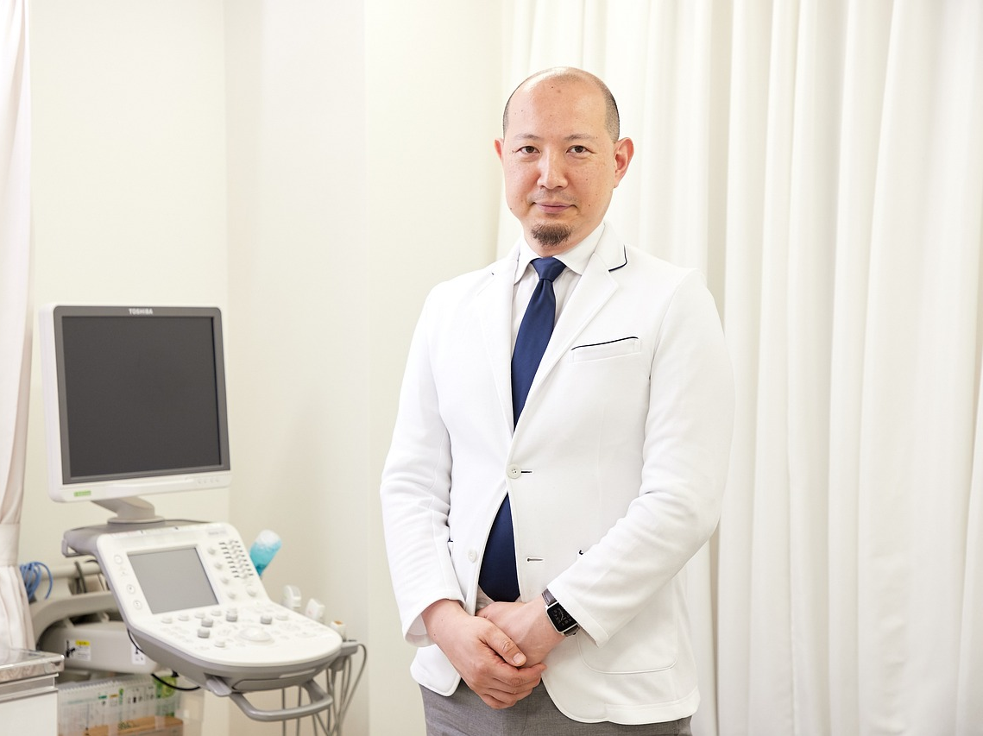
Several Abortion Providers Agree on
Risk Factors
A textbook by abortion doctors titled Management of Unintended and Abnormal Pregnancy: Comprehensive Abortion Care (Paul, et al., 2009) lists many risk factors in a chapter on counseling.

Slide 40
RISK FACTORS Acknowledged by Abortion Providers
1) Commitment and attachment to the pregnancy.
2) Perceived coercion to have the abortion.
3) Significant ambivalence about the abortion decision.
4) Putting great effort into keeping the abortion a secret.
5) Advanced stage of pregnancy.
6) Preexisting experience of trauma.
7) Past or present sexual, physical, or emotional abuse.
8) Unresolved past losses and perception of abortion as a loss.

Slide 41
RISK FACTORS Acknowledged by Abortion Providers
9) Fetal abnormality or other medical indications for the abortion.
10) Intense guilt and shame before the abortion.
11) An existing emotional disorder or mental illness prior to the abortion.
12) Appraisal of abortion as extremely stressful before it occurs.
13) Expecting depression, severe grief or guilt, and regret after the abortion.
14) Belief that abortion is the same act as killing a newborn infant.

Slide 42

American Psychological Association Acknowledged Risk Factors
A wanted or meaningful pregnancy
Pressure from others
Lack of social support
Commitment to the pregnancy
Ambivalence about the decision
Low perceived ability to cope
The APA acknowledged a number of risk factors for psychological distress in their 2008 Task Force Report.

Slide 43

Many adverse effects of abortion are evident in Jewels Green’s testimony. She is a speaker, writer and former abortion clinic worker, who succumbed to a highly pressured abortion at age 17 and wrote, “After spending a month in a psychiatric unit to recover, I worked in an abortion center for five years in an attempt to assuage my guilt, normalize my trauma, and rationalize away my pain. I wandered through life trying to fill the void where my baby should have been. Academic and career pursuits, moves to different states, marriage(s)--nothing satisfied me until I started speaking out about the anguish and regret I felt (and still feel) from my abortion.”

Slide 44

The International Institute for Reproductive Loss
There is expanding clinical awareness of the numerous ways reproductive loss, abortion in particular, may compromise psychological, spiritual, relational/social, and familial well-being.
Yet there remains a need to organize and synthesize the literature, practitioners’ knowledge, and personal narratives to deepen our understanding, formulate new research initiatives, provide education, and design innovative treatment interventions.
By focusing on scientific evidence, we will strive to substantively address gaps regarding how various forms of loss have both overlapping and distinct impacts on individuals, families, and communities.
Finally, we will be addressing the pro-choice bias in publishing and serve as strong advocates for accuracy and truth to be represented in the professional literature.

Slide 45

OUR VISION
Reproductive loss will be fully recognized internationally as a serious trauma for many individuals and families, who will have easy access to sophisticated scientific information packaged to be readily understood and used to back the development of efficacious treatment.

Slide 46

Where Science Meets Contemporary Reproductive Loss Needs

