Slide 1


Slide 2

Abortion and
Women’s
Relational
Health
International Institute for
Reproductive Loss
Priscilla K. Coleman, Ph.D.

Slide 3
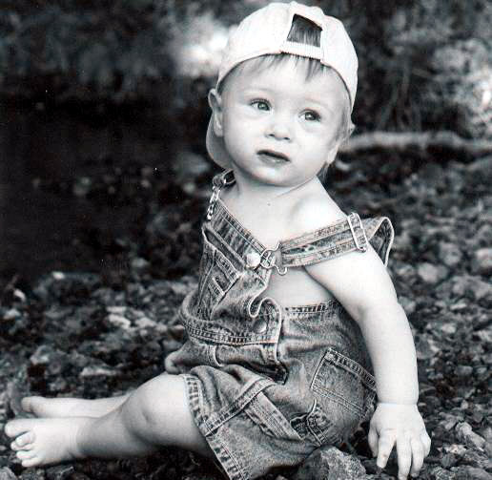

Abortion is
Inherently Relational

Slide 4
Abortion is
Inherently Relational
Resolution of an unplanned pregnancy is based on
each individual’s previous experiences, the couple’s
connection to one another, each partner’s relationship to
the developing fetus, and many other personal, relational,
and situational factors.
If a pregnancy is terminated, the abortion becomes a part
of the couple’s shared history with potential to seriously
impact their future.

Slide 5

Literature Review
Studies have linked abortion
with increased risk for various
problems:
Communication difficulties
Sexual problems
  loss of sexual desire
  reduced frequency of intercourse
  loss of orgasm ability
  reduced satisfaction
Domestic violence
Separation and divorce

Slide 6

Literature Review
In 2000 Lauzon and colleagues reported 12% of women and 18% of men indicated an abortion adversely affected their relationship.
In a large, well-controlled, longitudinal study by Barnett and colleagues (1992), 22% of German women’s relationships with their partners had ended by one year post-abortion.

Slide 7
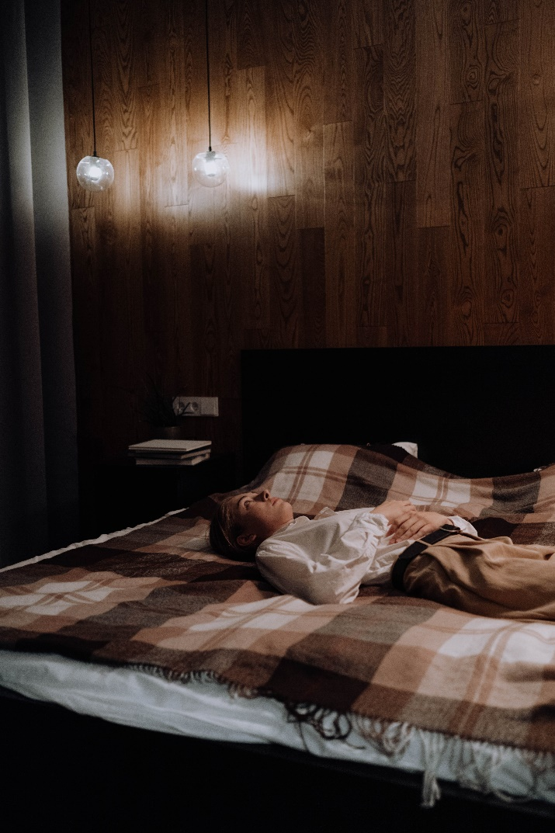
Literature Review
In a 2004 study led by Vincent Rue, 6.2% of Russian women and 24% of American women reported sexual problems directly attributed to a prior abortion.
In a Swiss longitudinal study of over 100 women, 31% reported at least one sexual problem 6 months post-abortion (Bianchi-Demicelli et al., 2002).

Slide 8

Literature Review
Bradshaw and Slade
concluded that 10-20% of
women experience sexual
problems in the early
months after an abortion
and 5-20% of women
report sexual difficulties a
year later.

Slide 9
Literature Review
Few studies on abortion-related sexual difficulties have explored why the problems arise. One study revealed decreased sexual desire was associated with not feeling worthy of one’s partner.
In studies of involuntary perinatal loss, sexual disinterest has been related to depression, fatigue, numbness, preoccupation, and discomfort based on sexual activity serving as a reminder of the previous conception, fear of pregnancy, and viewing pleasure as incompatible with mourning.

Slide 10
Sources of Conflict Pre-Abortion
1) Differences in opinion related to the humanity of
the fetus and the choice to abort.
2) Perceptions of a partner as insensitive or insufficiently
supportive.
3) Addressing relationship issues such as commitment,
desire to have children, confidence in a partner’s
parenting abilities, life-style factors, and long-term
goals necessary to arrive at a decision.

Slide 11
Post-Abortion Psychological Effects
There are many mechanisms through which
mental health problems may adversely affect
Relationships:
  Reduced emotional energy
  Withdrawn behavior
  Communication difficulties
  Feelings of self-doubt or limited personal control
  Blaming one’s partner for suffering incurred
  Substance abuse

Slide 12

2) Altered self-perceptions may result in
feelings of estrangement from one’s
partner.

Slide 13
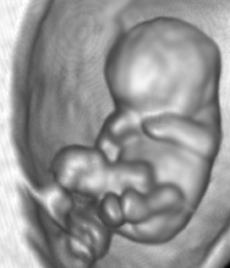
Belief in the humanity of the Fetus
Conklin and O’Connor (1995) found that women who believed the fetus was human were at risk for negative emotions, low self-esteem, and low life satisfaction post-abortion.
Negativity may be turned outward and incite adverse partner-directed behaviors.

Slide 14
Guilt
Studies show 29% to 75% of women who abort
report guilt feelings.
When consumed by abortion-related guilt, a
person may feel as though he or she does not
deserve to be happy or to be the recipient of a
partner’s love. Antagonistic behaviors that lead
to relationship problems may emerge.

Slide 15

Anger
Anger may be directed inward or outward.
Externally projected anger could be targeted toward a partner who pushed for an abortion or one who was emotionally detached.

Slide 16

Unresolved Grief/Bereavement
Kero and colleagues
(2004) found that 43%
of women reported
grief right before
abortion and
31% reported feelings
of grief one year later.

Slide 17

Unresolved Grief/Bereavement
In a study focusing on men,
Kero and Lalos found that
35% reported feelings of
grief and/or emptiness four
months post-abortion.
These researchers
concluded that abortion
was a “sad, ethically
painful, and problematic
act.”

Slide 18
Unresolved Grief/Bereavement
No studies have examined feelings of post-abortion grief as predictors of relationship problems.
However, two of the most frequently cited reasons for marital discord after a nonvoluntary pregnancy loss are incongruent bonding and incongruent grieving.
Women bond earlier to an unborn child than men, therefore at the time of the loss, it is possible that women have a stronger connection to the fetus and may suffer from a more significant grief response.

Slide 19

Unresolved Grief/Bereavement
If both partners experience grief, the nature and timing of their bereavement may differ based on gender differences.
Men tend to exert greater control over the expression of painful emotions, intellectualize grief, and cope alone.
Men are also inclined to identify their primary role as supporter for their partners.

Slide 20

The traditional research focus on individual responses to
abortion only sheds light on fragments of the larger
picture of the human cost of abortion..

Slide 21
Barnett W, Freudenberg N, Wille R. (1992). Partnership after induced abortion: A prospective controlled study. Arch Sex Behav 1992; 2:443-455.
Bianchi-Demicelli F, Perrin E, Bianchi PG, Dumont P, Ludicke F, Campana A. (2003). Contraceptive practice before and after termination of pregnancy: A prospective study. Contraception 2003; 76:107-113.
Bradshaw Z, Slade P. The effects of induced abortion on emotional experiences and relationships: A critical review of the literature. Clin Psychol Rev 2003; 23:929-958.
Conklin, M. P., & O'Connor, B. P. (1995). Beliefs about the fetus as a moderator of postabortion psychological well-being. Journal of Social & Clinical Psychology, 14, 76-95.
Kero, A., Hoegberg, U., & Lalos, A. (2004). Wellbeing and mental growth – long-term effects of legal abortion. Social Science and Medicine, 58, 2559-2569.
Lauzon P, Roger-Achim D, Achim A, Boyer R. Emotional distress among couples involved in first trimester abortions. Can Fam Physician 2000; 46:2033-2040.
Rue VM, Coleman PK, Rue JJ, Reardon DC. Induced abortion and traumatic stress: A preliminary comparison of American and Russian women. Med Sci Monit 2004;10: SR5-S16.

Slide 22

Where Science Meets Contemporary Reproductive Loss Needs

