Slide 1
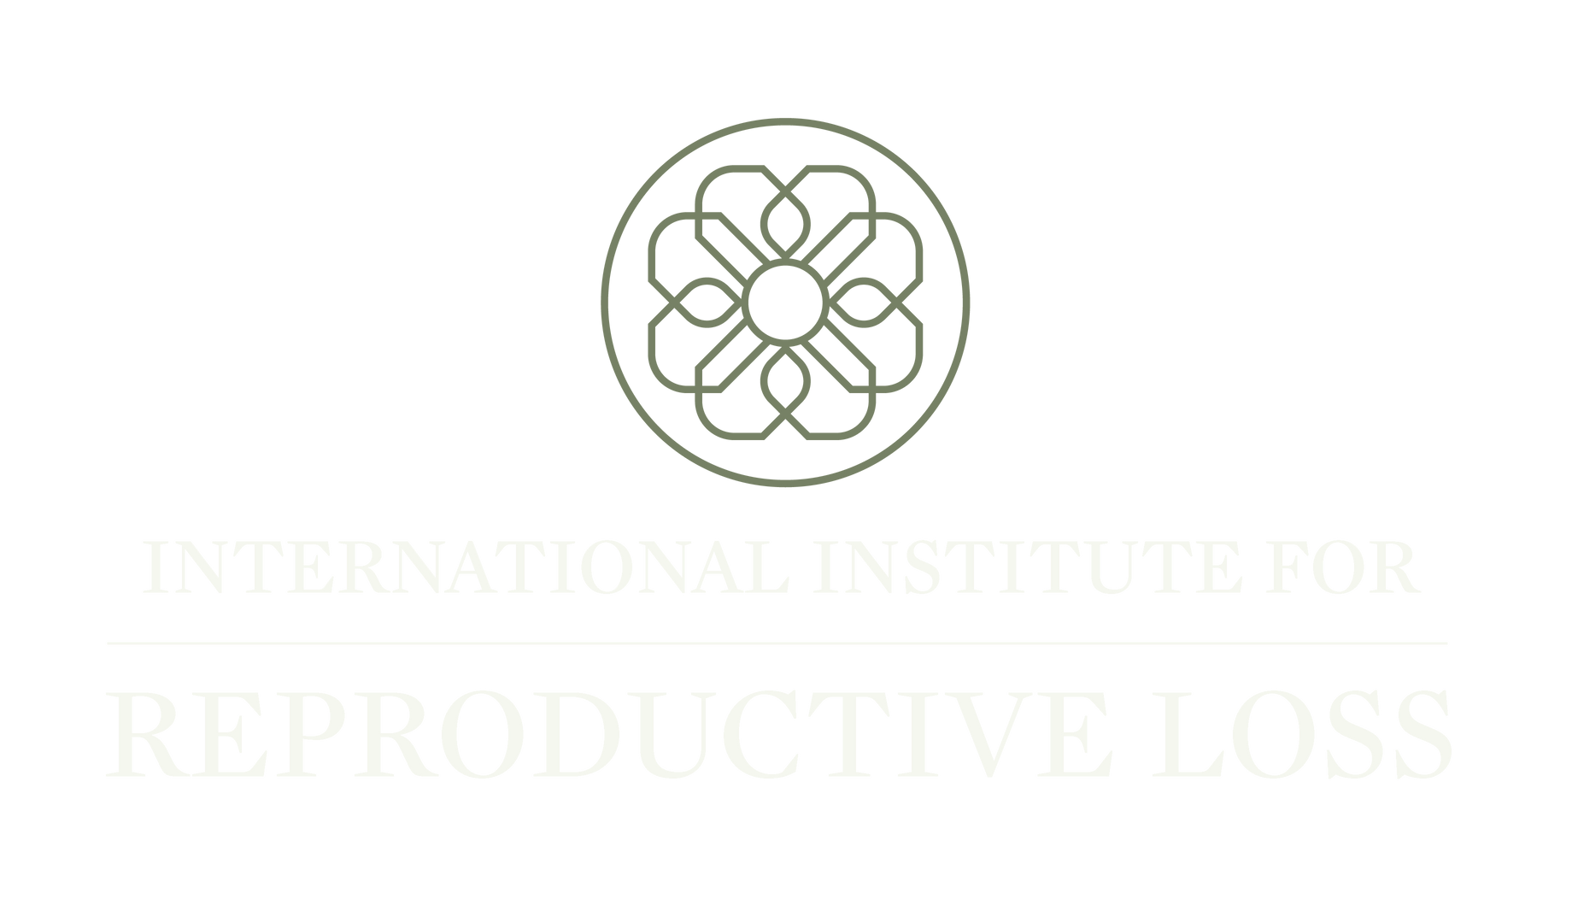

Slide 2

Stillbirth in global terms: general Information and
Psychological Implications
International Institute for Reproductive Loss
Priscilla K coleman, phd

Slide 3

General Information globally There are an estimated 2.64 million Stillbirths each year. global prevalence rates May be Inaccurate due to definitional Variations and poor recording.
- In the UK, stillbirth is defined as a baby born after 24-weeks gestation who does not show any signs of life.
- the United States and Australia most commonly define stillbirth as a fetus born after 20 completed weeks gestation.
- Sweden defines stillbirth as 28-weeks gestation.
- the World Health Organization (WHO) uses a definition of 22-weeks gestation.
A high number of stillbirths occur in pregnancies that have not had complications. in most cases the loss is very sudden, leaving parents feeling unprepared and in shock when they are told their baby has died.
(Campbell-Jackson & Horsch, 2014).

Slide 4

StillBirth in the US
The stillbirth rate in the United States is 5.73 per 1000. This translates out to approximately 1 in 175 pregnancies, accounting for about 21,000 infants lost per year.
Rates are much higher in low-income countries; however, the stillbirth rate in the U.S. is much higher than most higher income countries.
There are substantial disparities in stillbirth, with rates twice as high for non-Hispanic Black and Native Hawaiian or Other Pacific Islanders compared to non-Hispanic Whites.
(Silver & Reddy, 2024)

Slide 5

A Tragic Loss
Stillbirth is tragic for parents and families, with potential to cause extreme grief and serious psychosocial outcomes, including Posttraumatic Stress Disorder (PTSD), anxiety, depression, suicidal ideation, panic and phobias.
Stillbirth is also a critical risk factor for anxiety and depression during a subsequent pregnancy and the puerperium.
Campbell-Jackson & Horsch, 2014
Davoudian et al., 2021
Heazell et al., 2016
Sun et al., 2023

Slide 6
Psychological Impact Of StillBirth
The authors of a systematic review considered the psychological impact of stillbirth (from 20 weeks gestation) on mothers.
An extensive systematic search yielded 26 articles (8 qualitative, 18 quantitative studies) and the findings were synthesized.
Stillbirth was found to be a distressing experience with potential to evoke the following:
Anxiety
Depression
Distress
Negative well-being.
Symptoms were the highest in the first few months, although there was evidence that for some women, symptoms persist up to 3 years.
Risk factors for higher levels of anxiety and depression symptoms included higher parity and not being married.
Social support was identified as beneficial to women post loss.
The authors recommended additional research on risk and protective factors, cultural beliefs, and the impact on partner relationships. Campbell-Jackson & Horsch, 2014.
Campbell-Jackson, L., & Horsch, A. (2014).

Slide 7

Psychological Impact of stillbirth
In a more recent literature review, grief was identified as an expected, normative reaction to the experience of a perinatal loss. Major Depressive Disorder, Generalized Anxiety Disorder and Posttraumatic Stress Disorder were also found to be associated with perinatal loss.
Risk factors for these disorders included prior psychiatric illness, childlessness, unknown cause of perinatal loss, limited social support, and marital/relationship discord.
(Davoudian, Gibbins, & Cirino, 2021)

Slide 8
Stillbirth has potential to affect women’s approach to life and death, self-esteem, and their own identity (Heazell and colleagues, 2016). In an extensive review, Heazell et al. (2016) reported some women lose their sense of control, including in later pregnancies, and their confidence in parenthood and child-rearing.
Some women avoid contact with babies, creating social isolation and worsening depressive symptoms. Others reported being hesitant to meet their neighbors or those who had known them when pregnant. Many stopped going out.
Social isolation could also be involuntary, with parents reporting stigmatization, resulting in them feeling less valued as members of society.
PSYCHOsocial IMPACT OF STILLBIRTH

Slide 9
PSYCHOLOGICAL IMPACT OF STILLBIRTH
The authors of a large review published in the Lancet noted that despite the frequency of stillbirths, the impact has not received the systematic attention deserved.
They combined the findings from comprehensive, systematic literature reviews, and new analyses of published and unpublished data to derive comprehensive conclusions regarding the impact of stillbirth on parents, families, health-care providers, and societies worldwide.
Stillbirth was identified as needing more resources than livebirth in the perinatal period and beyond, particularly during subsequent pregnancies.
The authors noted, “indirect and intangible costs of stillbirth are extensive and are usually met by families alone”, commenting further that adverse effects on parental mental health might be moderated by empathic attitudes of care providers and interventions tailored specifically to the experience. The authors concluded, “The value of the baby, as well as the associated costs for parents, families, care providers, communities, and society, should be considered to prevent stillbirths and reduce associated morbidity.” (Heazell & colleagues, 2016).

Slide 10
Best strategies For Enhancing Healing Post-Stillbirth
In Heazell and colleagues (2016) literature review, 43 studies provided evidence on what works to reduce the negative impact of stillbirths.
The key findings of all included studies (qualitative and quantitative) were mapped to Sarafino’s Taxonomy of Social Support, with 5 support elements: Tangible, Emotional, Esteem, Informational, and Network/belonging.

Slide 11
Best strategies For Enhancing Healing Post-Stillbirth
In the Heazell review, all effective interventions, and all qualitative studies of interventions with positive participant responses, included emotional support.
Nine included informational support, and 10 addressed tangible support. Usually, this was help from staff to see and hold the baby after birth (14 studies).
Two studies included esteem support, such as help with reclaiming a lost sense of motherhood or fatherhood.
Eight involved networking/belonging. Positive staff attitude was universally appreciated

Slide 12
Best strategies For Enhancing Healing Post-Stillbirth
Further reported in the Heazell review, effective interventions included: seeing and holding the baby, social support/support groups, making and sharing memories, autopsy, psychological interventions, and interventions with multiple components.
Professional support to enable parents to share their experiences with others, and social support from family and local social networks were both associated with lower rates of depression and better mental health.
Programs with multiple components generally increased parents’ satisfaction, with those more satisfied reporting less grief. Where measured longitudinally, this effect was maintained for up to 2 years.

Slide 13

Women’s stories
In June of 2015, the New York Times published a moving story on the trauma of stillbirth, “Stillbirth: Your Stories”. A few of the testimonies are reproduced here to illustrate the range and the depth of experiences.
https://www.nytimes.com/interactive/2015/health/
stillbirth-reader-stories.html

Slide 14

parents’ stories “Aisha”
“There is so much shame that comes in the moment of delivering a dead or dying baby. We feel like we should get the goodbye over too fast. Don't. We have so many hormones and feelings that want us to care for our newborn but you only get one chance - bathe, diaper, dress the baby, take pictures. Weigh and measure and footprint the baby. Talk to the baby and explore his body. Take lots of photos because you will want to remember the baby. You will need proof that he was really there when you are alone and sad and angry and milk is pouring out of your breasts. It will all feel like a bad dream and you will need proof. Know that you are forever changed by your loss and you will be hit by it over and over on his birthdays, when you have another baby, when he would have started kindergarten. Develop rituals when you are sad. Talk about the baby. Tell your future kids about it. Tell strangers about it. Get a tattoo in a prominent place to get others to ask you about it. Embrace the new, changed you and let go of any expectation of getting over it.”

Slide 15

parents’ stories “Christopher”
“Take as much time as you need to embrace the grief and begin healing your body and soul. There is no timetable for this, because enduring grief is different for each individual, and each couple. But there is no point trying to deny your pain or run from it because the grief will follow you and come like a thief in the night. It's been nearly six years since we lost our son, and it took us almost two years of grieving to be ready to have another child. Since then, we've had two beautiful boys born to us. But sometimes unexpectedly, the trauma of watching my wife deliver our stillborn son still comes over me like a wave. But if this happens to you, let the tears flow because they have a redemptive, healing effect. I say this especially to fathers who have lost a child. American society tells us we must be strong and that showing emotion is a sign of weakness. But that is wrong. You must let yourself grieve or it will haunt you forever.”

Slide 16
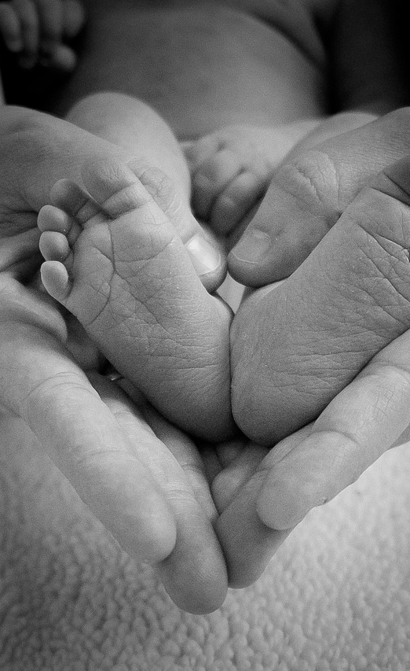
parents’ stories “Anika”
“We were 26 weeks into our first pregnancy with our sweet little girl, Brooklyn Skye, when our world made a change in a direction no one expected. Her movement decreased but being that it was my first pregnancy and still fairly early I was challenged with what my heart was telling me. The biggest heart break of a lifetime came when the nurse grabbed my foot when the ultrasound at the hospital showed no heartbeat. Brooklyn was born still Nov. 19, 2013. No words can explain the pain that your heart and soul experience when you lose your baby, when you lose your dreams, when you lose your entire world. Alone. What now? Why? How do you move on? The thought of moving on made me sick and angry. As each day went on so did the pain. Would it ever stop?...no. One of the best decisions I made during this experience was to see a therapist shortly after losing Brooklyn. Talking about my loss has given me strength and allowed me to honor our sweet angel.”

Slide 17

parents’ stories “kailea”
“My husband and I lost our daughter. After the first trimester you think you are in the clear. You won't lose your baby. I now know that is not true. I was 35 weeks pregnant when we found out my daughter didn't have a heartbeat. My world and my life have never been the same after her birth. I know one in four pregnancies ends in either a miscarriage or a stillbirth. There are 26,000 families that experience stillbirth every year. I want to tell these families that they are not alone. The worst thing you could possible do is to isolate yourself. I did that. I wanted to shut the world out and hide under the blankets and cry. And I did that. I cried and cried and couldn't get out of bed. My husband and I were different. We were sad and angry. Angry at each other. As a couple facing the loss of their child it's hard not to be angry at each other. You want to blame someone for your loss, so you blame each other. Please don't blame each other. Communication is the most important thing. It wasn't until after a huge fight my husband and I finally broke the silence. We let all of our frustrations out and we were finally able to heal with each other. Grieve with each other and not alone.”

Slide 18
References
Campbell-Jackson, L., & Horsch, A. (2014). The Psychological Impact of Stillbirth on Women: A Systematic Review. Illness, Crisis & Loss, 22(3), 237-256.
Davoudian, T., Gibbins, K., & Cirino, N. H. (2021). Perinatal loss: The impact on maternal mental health. Obstetrical & Gynecological Survey, 76(4), 223–233.
Heazell, A. E., Siassakos, D., Blencowe, H., Burden, C., Bhutta, Z. A., Cacciatore, J., Dang, N., Das, J., Flenady, V., Gold, K. J., Mensah, O. K., Millum, J., Nuzum, D., O'Donoghue, K., Redshaw, M., Rizvi, A., Roberts, T., Toyin Saraki, H. E., Storey, C., … Lancet Ending Preventable Stillbirths Series study group; Lancet Ending Preventable Stillbirths investigator group. (2016). Stillbirths: Economic and psychosocial consequences. Lancet, 387(10018), 604–616.
Silver, R. M., & Reddy, U. (2024). Stillbirth: we can do better. American journal of obstetrics and gynecology, S0002-9378(24)00628-8. Advance online publication.
Sun, S., Qian, J., Wang, F., Tian, Y., Sun, Y., Zheng, Q., & Yu, X. (2023). Impact of contact with the baby following stillbirth on parental mental health and well-being: A systematic review and meta-analysis. International journal of nursing practice, 29(6), e13146. https://doi.org/10.1111/ijn.13146

Slide 19

Where Science Meets Contemporary Reproductive Loss Needs

