Slide 1


Slide 2

Reproductive Outcomes and
Mortality: Debunking the Myth that Abortion is Safer than Childbirth
Priscilla K. Coleman, Ph.D.
International Institute for Reproductive Loss

Slide 3
The following information appears on Planned Parenthood’s “Factsheet” (https://cdn.plannedparenthood.org/uploads/filer_public/f6/4c/f64c8d6e-00a6-4a65-a04c-e5eaee0ba001/abortion_fact_sheet_with_sources.pdf)
“Abortion is safer than childbirth in the US; women are about 14 times more likely to die in childbirth than from an abortion.”

Slide 4

General Purpose
The overarching purpose of this presentation is to show how entirely false and misleading the Planned Parenthood claim is and to demonstrate why abortion is in fact more likely to precipitate a maternal death when compared to childbirth.

Slide 5
Specific Objectives
1. Address the myriad ways that abortion may be directly and indirectly associated with an increased probability of dying in the days, months, and years following abortion.
2. Explain how childbirth is often health enhancing for women and is thereby associated with a lower probability of death in the short- and long-term.

Slide 6
Specific Objectives
3. Describe the problems in data collection and reporting that have distorted the truth regarding the relative risks of abortion and childbirth.
4. Cover record-based studies and explain why they offer the most defensible data when attempting to illuminate the relative risk of death with abortion compared to childbirth.
5. Discussion of a record-based study employing Danish Health Registries that Dr. Coleman conducted with colleagues.

Slide 7
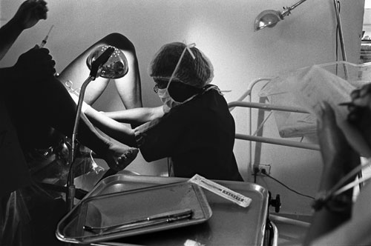
Direct Causes of
Abortion-Related Deaths
According to Chang et al. (2003), the three main causes of abortion-related deaths are:
1) Infection (33.9%)
2) Hemorrhage (21.8%)
3) Embolism (13.9%).

Slide 8
Direct Causes of
Abortion-Related Deaths
Additional abortion related causes of death include ectopic pregnancy, perforation or rupture of the uterus, and anesthesia complications among others.
Hemorrhage and infection deaths from abortion are nearly 8 times and 9 times greater when compared to the percentage of maternal deaths attributed to these causes in live-birth.
Approximately 10% of women undergoing abortion will encounter immediate complications and 2% are considered life-threatening.

Slide 9

Indirect Causes of
Abortion-Related Deaths

Slide 10

Indirect
Causes of
Abortion-
Related
Deaths:
Psychological Problems

Slide 11

Abortion-related guilt, grief, anxiety, and depression can lead to apathy regarding health and healthcare habits and a compromised immune system response, which may lead to a wide range of illnesses.

Slide 12

  Abortion-related psychological problems may also increase a person’s chance of engaging in self-harm even if not motivated by suicidal thoughts, and of becoming a victim of an accident or violence.

Slide 13

In contrast…psychological benefits of motherhood
A number of studies have shown positive psychological characteristics, including an increased sense of control, feelings of serenity, self-esteem, empathy, ego resiliency (capacity for flexibility and resourcefulness in coping with stressors), and assertiveness associated with motherhood.

Slide 14

Psychological Benefits of Motherhood
According to Ellison (2005), frequent close contact inherent in the daily care of a young child results in expanded maternal brain activity and neural growth.

Slide 15

Psychological Benefits of Motherhood
As mothers monitor and attend to children’s needs, brain circuits related to empathy are expanded.
Elevated cortisol levels in new mothers may boost attention, vigilance, and sensitivity.

Slide 16

Research reveals that most women who are nearing the end of pregnancy are quite comfortable and content with being pregnant, even when the pregnancy was not planned.

Slide 17

Psychological Benefits of Motherhood
For example, when comparing 248 British women experiencing a planned pregnancy to 182 women experiencing an unplanned pregnancy, Deave (2005) found that 87% of women who planned their pregnancies and 79% of women who did not, reported feeling pleased or overjoyed just prior to delivery. The women were all first-time mothers, residing in lower socioeconomic areas, with a mean age of 26.

Slide 18

Psychological Benefits of Motherhood
In a study by Rokach (2004), mothers in their 1st year of parenting scored significantly lower on a loneliness measure than women in the general population.
The subscales included emotional distress, social inadequacy and alienation, interpersonal isolation, and self-alienation (detachment from oneself, numbness). This suggests new mothers are at lower levels of risk for mental health problems.

Slide 19

Psychological Benefits of Motherhood
If women breastfeed, there are additional benefits, as lactation produces the antidepressant chemical, oxytocin. Studies suggest lactating mothers are less tense and become bored less easily than their non-lactating peers. The hormonal activity and neural circuitry associated with childbirth and lactation reduces depression and anxiety and ushers in a quiet joy (Ellison, 2005; Kinsley & Lambert, 2006).

Slide 20

The brain becomes more receptive to the impact of oxytocin after the first heavy dose during labor and breast feeding. Hormones of pregnancy and early motherhood apparently facilitate formation of subsequent strong personal relationship bonds.

Slide 21

Indirect Causes of
Abortion-Related
Deaths:
Increases in Maladaptive Behaviors

Slide 22

Casual sexual activity associated with abortion experience can lead to STIs, Cancer (HPV), AIDS.
Risk-taking can lead to one becoming a victim of violence or accidents.
Substance abuse can initiate physical heath ailments such as cardiovascular disease, liver damage, etc.

Slide 23
Childbirth is Protective Against Death due to Suicide
Gissler and colleagues (2005) reported the annual suicide rate for women of reproductive age to be 11.3 per 100,000; whereas the rate was only 5.9 per 100,000 in association with birth (and was a startling 34.7 per 100,000 following abortion).
Gissler and Colleagues (2015) examined suicide trends after induced abortion from 1987 to 2012 in Finland. Women with a recent induced abortion have a 2-fold suicide risk even after care guidelines included a 2-3 week follow-up session with abortion patients to monitor for mental health disorders.

Slide 24

Several other studies have revealed even lower rates of suicide in the year following birth when compared to non-postpartum samples.

Slide 25
United States and Canada
The postpartum suicide rate was found to be only 1.4 per 100,000 by Schiff and Grossman (2006).
Lower rates of suicide have been observed among postpartum women compared to non-postpartum women (Turner et. al. 2002).
.

Slide 26
England and Wales
In a population-based study, Appleby (1991) reported in the British Medical Journal that pregnant women are 1/20th as likely to commit suicide when compared to non-pregnant women of childbearing age .
In a review of the literature, Lindahl and colleagues (2005) concluded that suicide deaths are lower among postpartum women compared to the general population.

Slide 27

What about Post-Partum
Depression?

Slide 28

What about Post-Partum Depression?
The incidence rate for postpartum depression is between 3.4% and 11%
(Akman et al., 2007).
However this form of depression tends to be less serious than Major Depression, which has been shown to afflict 20% of women after abortion. Moreover, post-partum depression is very unlikely to precipitate suicide (Turner et al., 2002).

Slide 29

What about Post-Partum Depression?
In a large review of the literature on postpartum and non-postpartum depression, Whiffen and Gotlib (1993) concluded “there is solid evidence that the typical episode of postpartum depression is mild” and the primary difference between postpartum depression and non-postpartum depression was found to be symptom severity.

Slide 30
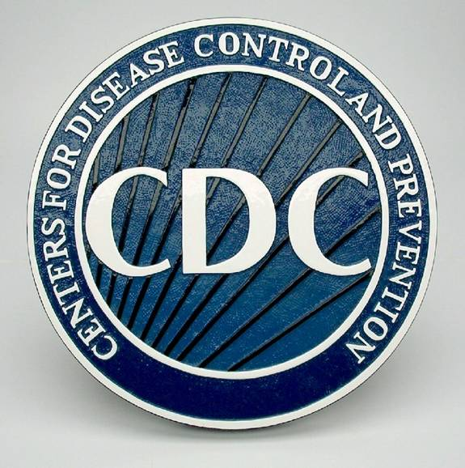
Challenges to Securing Accurate Abortion Mortality Data in the U.S.
The data reported by abortion clinics to state health departments and ultimately to the Centers for Disease Control (CDC) in the U.S. significantly underrepresents abortion mortality for several reasons:
1) Abortion reporting is not required by federal law and many states do not report abortion-related deaths to the CDC.

Slide 31

Challenges to Securing Accurate Abortion Mortality Data in the U.S.
2) Deaths due to medical and surgical treatments are reported under the complication of the procedure (e.g., infection) rather than the treatment (e.g., induced abortion).
3) Most women leave abortion clinics within hours of the procedure and go to hospital emergency rooms if there are complications that may result in death.

Slide 32

Challenges to Securing Accurate Abortion Mortality Data in the U.S.
4) Suicide deaths are rarely, if ever, linked back to abortion in state reporting of death rates.
5) An abortion experience can lead to physical and/or psychological disturbances that increase the likelihood of dying years after the abortion, and indirect abortion-related deaths are not captured at all.

Slide 33

6) Abortion-related deaths beyond the first trimester, which constitute 12-13% of all abortions are rarely mentioned.
Using national U.S. data spanning the years from 1988 to 1997, Bartlett and colleagues reported the relative risk of mortality was 14.7 per 100,000 at 13–15 weeks of gestation, 29.5 at 16-20 weeks, and 76.6 at or after 21 weeks.

Slide 34

Challenges to Securing Accurate Maternal Mortality Data
Acquiring and disseminating
accurate data pertaining to maternal mortality are global concerns.
According to the World Health
Organization: “Maternal deaths are hard to identify because this requires information about deaths among women of reproductive age, pregnancy status at or near the time of death, and the medical cause of death. All three components can be difficult to measure accurately.”

Slide 35
Challenges to Securing Accurate Maternal Mortality Data
A study of pregnancy-associated deaths in Finland revealed that without data linkage to complete pregnancy and abortion records, 73% of all pregnancy associated deaths could not be identified from death certificates alone (Gissler et al., 2004).
Inconsistent definitions and incomplete data confined to a very brief window of time has left society largely in the dark regarding true mortality risks associated with pregnancy generally and with particular outcomes, both immediately after pregnancy resolution and across the years that follow.

Slide 36

Population-Based Record Linkage Studies
Large population-based record-linkage studies, containing complete reproductive history data in conjunction with data related to deaths, provide a unique opportunity to bypass
many of the limitations of the currently available maternal mortality data in most countries.

Slide 37

Population-Based Record Linkage Studies
In 2004 Gissler and colleagues again found that mortality was significantly lower after a birth (28.2 per 100,000) than after a spontaneous abortion (51.9 per 100,000) and following an induced abortion (83.1 per 100,000).

Slide 38

Reproductive History and Long-Term Mortality Rates: Danish Population-Based Study

Slide 39
Danish Population-Based Study: Methodology
The study included all women in Denmark born between the years 1962 and 1993, who were alive on Jan 1st 1980 and did not die prior to age 16 (n=1,001,266).
The average age of women at the end of their first pregnancy was 25 and 29 at the end of their last pregnancy. The average number of pregnancies per woman was 1.2.
The 5,137 recorded deaths occurred between January 11, 1980 and December 31, 2004, and the mean age at death was 27 years.

Slide 40
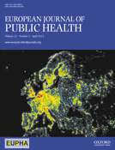
Study 1: Coleman, P. K., Reardon, D. C., & Calhoun, B. C. (2013). Reproductive History Patterns and Long-Term Mortality Rates: A Danish, Population Based Record Linkage Study.
European Journal of Public Health. European Journal of Public Health (2013) 23 (4): 569- 574.

Slide 41
Study 1: Objective
The general purpose was to explore the effects of particular patterns of pregnancy resolution (induced abortion, miscarriage, and birth) on mortality rates over an extended time frame (25 years).
.

Slide 42
Study 1: Results
With controls for the number of pregnancies, year of birth, and age at last pregnancy, having experienced only induced abortion(s) and natural loss(es) was associated with over 3 times the risk of death from all causes compared to only having experienced birth(s).
Risk of death was over 6 times greater among women who had never been pregnant compared to those in the birth(s) only group.

Slide 43
Study 1: Results
Compared to a reproductive history that only included births, after instituting controls, increased risk of death were as follows:
  Only induced abortion(s): 66%
  Only natural loss(es): 181%
  All reproductive outcomes 94%

Slide 44
Study 1: Results
Compared to no experience of abortion, increased mortality risks after applying controls were evidenced for the following:
  One abortion: 45%
  Two abortions: 114% increased
  Three abortions: 191% increased risk of death
Similarly, increased risks of death were equal to 44%, 86%, and 150% for 1, 2, and 3 natural losses respectively compared to no natural losses.

Slide 45

Study 1: Results
Significantly decreased mortality risks were evidenced with multiple births:
2 births were associated with an 83% lower risk of death compared to no births.
3 or more births corresponded to a 44% decreased risk over no births.

Slide 46

Study 2: Reardon, D. C., & Coleman, P. K. (2012). Short and Long Term Mortality Rates Associated with First Pregnancy Outcome: Population Register Based Study for Denmark 1980-2004. Medical Science Monitor, 18(9).

Slide 47
Study 2 Objectives
1. To examine mortality rates associated with first pregnancy outcome.
2. To examine differences in mortality rates associated with early abortion and late abortions (after 12 weeks).

Slide 48
Study 2: Results
Over 460,000 women had their 1st pregnancy between 1980 and 2004, of whom 2,238 died.
Compared to women who delivered, the age and birth year adjusted cumulative risk of death for women who had a 1st trimester abortion was significantly higher in all periods examined from 180 days (OR=1.84) through 10 years (OR=1.39).

Slide 49
Study 2: Results
The risk of death was significantly higher for women who had abortions after 12 weeks from one year (OR=4.31) through 10 years (OR=2.41).
For women who miscarried, the risk was significantly higher for cumulative deaths through 4 years (OR=1.75) and at 10 years (OR=1.48).

Slide 50

University of Chile researcher, Elard Koch published a paper in the Journal PLos One titled “Women’s Education Level, Maternal Health Facilities, Abortion Legislation and Maternal Deaths: A Natural Experiment in Chile from 1957 to 2007”

Slide 51

The researchers accessed the Chilean National Institutes of Statistics for governmental data on maternal deaths and live births from 1957 to 2007. Vital registration in Chile is virtually complete, yielding high quality data.

Slide 52
Study Objectives
He assessed variables related to maternal mortality reduction in Chile since therapeutic abortion was made illegal in 1989.

Slide 53

Results
After abortion prohibition, maternal mortality decreased from 41.3 to 12.7 per 100,000 live births ―a decrease of 69.2% in fourteen years.
In 2007, the absolute risk of dying from abortion in Chile was 0.046 per 100,000 women of fertile age ―one in two million women between 15 and 49 years old.

Slide 54
The study clearly demonstrated that contrary to a frequently voiced (yet never empirically substantiated) claim by researchers and policymakers, illegal abortion did not result in increased maternal deaths due to clandestine abortions.

Slide 55

Stacy Zallie (1981-2002)

Slide 56
At age 20 as a result of pressure from her boyfriend, Stacy underwent an abortion. Shortly afterwards she asked for psychiatric help, but she ended therapy after only 3 months. Sadly after several suicide attempts, she hung herself in her room. Her parents didn’t know about the abortion until after her death. In her suicide note she expressed desire to be reunited with her unborn baby, “Brittany Leigh”.

Slide 57

Stacy’s dad started an organization in Stacy’s name to assist women suffering from an abortion find the help they need.

Slide 58
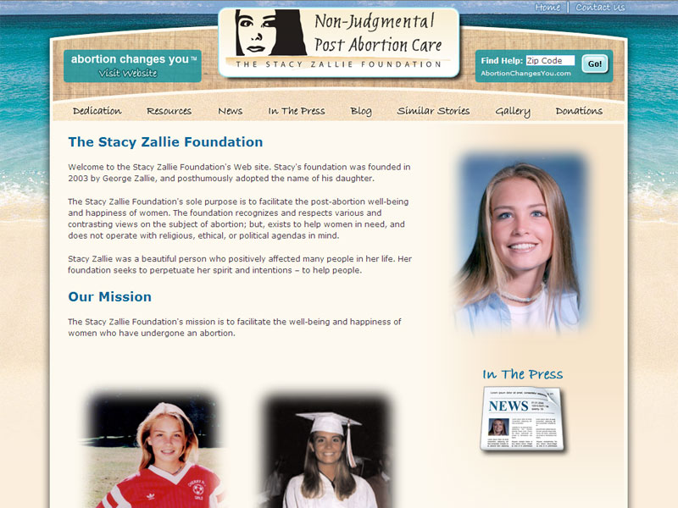

Slide 59
The personal impact of abortion is often profound human suffering, with the most serious cases, like that of Stacy Zallie, entailing lives full of potential, needlessly ending long before they should. Continued denial and distortion of the literature by abortion clinic personnel, the media, and professional organizations , leaves hundreds of thousands of women untreated like Stacy. Each day a significant number similarly find the shame, loss, and depression of abortion simply incompatible with life.

Slide 60
Akman, C., Uguz, F., & Kaya, N. (2007). Postpartum-onset major depression is associated with personality disorders. Comprehensive psychiatry, 48(4), 343–347. https://doi.org/10.1016/j.comppsych.2007.03.005
Appleby L (1991) Suicide after pregnancy and the first postnatal year. British Medical Journal, 302: 137–140.
Bartlett, L. A. et al. (2004). Risk Factors for Legal Induced Abortion-Related Mortality in the United States. Obstetrics & Gynecology, 103 (4), 729–37.
Chang, J., Elam-Evans, L. D., Berg, C. J., Herndon, J., Flowers, L., Seed, K. A., Syverson, C. J. (2003). Pregnancy-related mortality surveillance-United States, 1991–1999. MMWR, 52, 1–8.
Deave, T. (2005). Associations between child development and women’s attitudes to pregnancy and motherhood. Journal of Reproductive and Infant Psychology, 23(1), 63-75. doi: 10.1080/02646830512331330938
Ellison, K. (2005). The mommy brain: How motherhood makes us smarter. Basic Books: Philadelphia, PA.
Gissler, M., Berg, C., Bouvier-Colle, M., Buekins, P. (2004). Pregnancy-associated mortality after birth, spontaneous abortion, or induced abortion in Finland, 1987-2000. American Journal of Obstetrics and Gynecology, 190, 422-427.
Gissler, M., et al. (2005). Injury deaths, suicides and homicides associated with pregnancy, Finland 1987-2000. European Journal of Public Health, 15, 459-463.

Slide 61
Gissler M., Karalis, E., Ulander, V.M. (2015). Decreased suicide rate after induced abortion, after the Current Care Guidelines in Finland 1987-2012. Scand J Public Health, 43(1), 99-101.
Kinsley, C. H., Lambert, K. G. (2006). The maternal brain. Scientific American, 294, 72-76. Retrieved from https://kennedy.auhsd.us/view/4658.pdf.
Lindahl V, Pearson JL, Colpe L. Prevalence of suicidality during pregnancy and the postpartum. Arch Womens Ment Health. 2005;8:77–87.
Rokach, A. (2004). Giving life: Loneliness, pregnancy, and motherhood. Social Behavior and Personality, 32(7), 691-702. doi: 10.2224/sbp.2004.32.7.691.
Schiff, M. A., & Grossman, D. C. (2006). Adverse perinatal outcomes and risk for postpartum suicide attempt in Washington state, 1987-2001. Pediatrics, 118(3), e669–e675. https://doi.org/10.1542/peds.2006-0116
Turner, L. A., Kramer, M. S., Liu, S., & Maternal Mortality and Morbidity Study Group of the Canadian Perinatal Surveillance System (2002). Cause-specific mortality during and after pregnancy and the definition of maternal death. Chronic diseases in Canada, 23(1), 31–36.
Whiffen, V. E., & Gotlib, I. H. (1993). Comparison of postpartum and nonpostpartum depression: clinical presentation, psychiatric history, and psychosocial functioning. Journal of consulting and clinical psychology, 61(3), 485–494. https://doi.org/10.1037//0022-006x.61.3.485h

Slide 62

Where Science Meets Contemporary Reproductive Loss Needs

