Slide 1


Slide 2


Interpersonal
Violence, COERCED Abortion, and an Opportunity to Intervene and Save Women’s Lives
INTERNATIONAL INSTITUTE FOR REPRODUCTIVE LOSS Priscilla K. Coleman, ph.d.

Slide 3

Tiffany Gillespie
In February 2012, Philadelphia resident Tiffany Gillespie, 24, was 6-months pregnant with her 3rd child when she was allegedly shot to death by her boyfriend, Aaron Fitzpatrick.
The killing followed an argument in which Fitzpatrick tried to convince her to have an abortion and she refused.

Slide 4

Valarie Luckenbihl
In another recent case in Wyoming, Timothy Kindle repeatedly beat his 17-year-old partner intending to induce an abortion. Kindle is now facing up to 10 years in prison and/or $10,000 in fines for killing her unborn baby.
Valarie Luckenbihl lived; however, as a survivor she is at a significantly increased risk for mental health problems including depression, anxiety, posttraumatic stress disorder, and suicidal behaviors, as well as a wide range of adverse physical health outcomes.

Slide 5

Research indicates that unplanned pregnancy significantly increases the likelihood of victims of Intimate Partner Violence (IPV) being murdered (Williams & Brackley, 2009).

Slide 6

The decision regarding resolution of an unplanned pregnancy in relationships involving IPV is likely to be dominated by the abusive,
control-oriented partner.

Slide 7
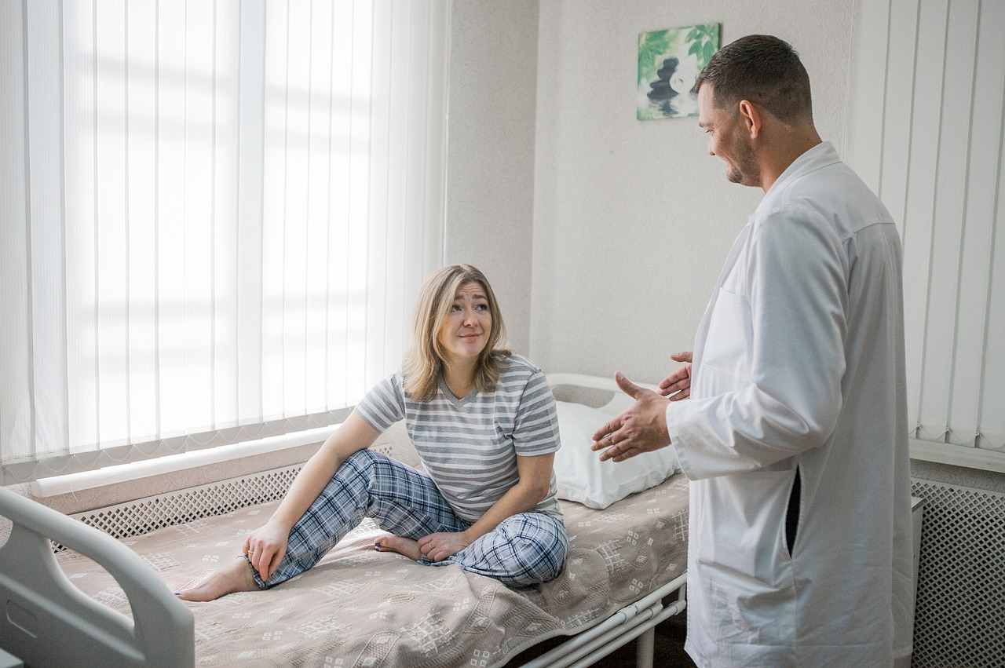
Fortunately, pregnant women generally have more contact with healthcare professionals compared
to non-pregnant women, and visits can operate as a critical point of intervention. Screening for IPV is particularly important among women seeking abortions, since they are more likely to be victims of IPV than women who continue their pregnancies.

Slide 8
Presentation Objectives
1) Examine the literature pertaining to Intimate Partner Violence (IPV) generally and during pregnancy.
2) Consider research demonstrating that IPV victims are at an increased risk for unplanned pregnancy and abortion.
3) Describe methods that clinicians employ to screen for IPV.

Slide 9

Presentation Objectives
4) Underscore the dire need for screening for IPV at abortion clinics to help women make independent choices regarding pregnancy resolution, leave abusive relationships, and save lives.

Slide 10
Intimate Partner Violence Overview
Definitions and Statistics

Slide 11

What Constitutes
Intimate Partner Violence or Abuse?

Slide 12
What Constitutes IPV or Abuse?
“Intimate partner violence (IPV; also known as domestic violence) refers to behaviour by an intimate partner or ex-partner that can cause or causes physical, sexual or psychological harm. These behaviours include physical aggression, sexual coercion, psychological abuse and controlling behaviours. Stalking and financial abuse have now been included in the list of IPV behaviours by some authorities.” Stewart, MacMillan, & Kimber (2021, p. 71).

Slide 13

What Constitutes IPV or Abuse?
Physical abuse includes violent acts such as pushing, shoving, throwing, biting, choking, shaking, punching, burning, etc., use of a weapon, and/or use of restraints or one's body, size, or strength against another person.

Slide 14


What Constitutes IPV or abuse?
Psychological abusive involves behaviors such as intimidation, threatening, belittling, humiliating, controlling what the victim can and cannot do, withholding information from the victim, deliberately doing something to make the victim feel diminished or embarrassed, isolating the victim from friends and family, and denying the victim access to money or other basic resources.

Slide 15
What Constitutes IPV or Abuse?
Intimate partner sexual assault is any unwanted sexual contact or forced acts of a sexual nature that are committed by a current or past spouse or partner. More specifically, the World Health Organization recently defined it as being physically forced to have sex, having sex for fear of what the partner might do, and/or being compelled to do something sexual that was humiliating or degrading.

Slide 16
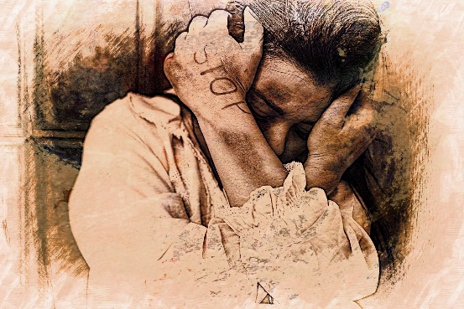
What Constitutes IPV or Abuse?
Forced intercourse within a marriage is often called "marital rape." Like other forms of domestic violence, marital rape is about exerting power and control over one’s partner.

Slide 17
What Constitutes IPV or Abuse?
As of 2024, it is illegal in all 50 states, however, several states provide legal loopholes or defenses when it comes to prosecuting marital rape. For example, New York provides a defense to sex crimes if the defendant is married to the victim and the crime is based on lack of consent due to a mental disability or age. (N.Y. Penal Law § 130.00, 2022).
Marital rape has been criminalized by approximately 150 countries as of 2019.

Slide 18

The Complexity of IPV
IPV is increasingly recognized as a complex process wherein women feel high levels of vulnerability, powerlessness, and entrapment resulting from a partner’s systematic employment of physical, sexual, psychological, and/or moral force.
As noted by Cobia, Robinson, and Edwards (2008, p. 249) “Violence against women is often accompanied by emotionally abusive and controlling behavior, and thus is part of a systematic pattern of dominance and control. Domestic violence results in physical injury, psychological trauma, and sometimes death. The consequences of domestic violence can cross generations and truly last a lifetime).”

Slide 19
Alarming Statistics
The cases described at the outset of this presentation are sadly not isolated events. Their stories are echoed in the lives of countless women, many of whom lack the necessary support to free themselves.
IPV is common, affecting millions of women in the U. S. each year. Data from the CDC’s National Intimate Partner and Sexual Violence Survey (NISVS) indicated approximately 41% of women have experienced sexual violence, physical violence, and/or stalking by an intimate partner. Over 61 million women have experienced psychological aggression by an intimate partner in their lifetime.

Slide 20
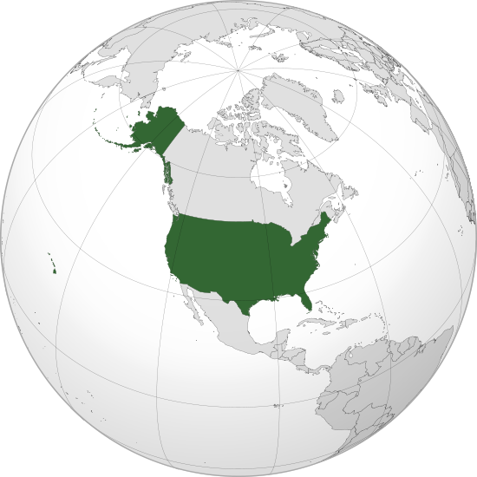
Alarming Statistics: U.S.
Of the estimated 4,970 female victims of murder and nonnegligent manslaughter in 2021, data reported by law enforcement agencies indicate that 34% (1,690) were killed by an intimate partner.
United States Bureau of Justice Statistics https://bjs.ojp.gov/female-murder-victims-and-victim-offender-relationship-2021

Slide 21
Alarming Statistics: World
World-wide lifetime risk for physical and/or sexual IPV varies from 15% to 71%.
Between 13% and 61% of women 15–49 years old report that an intimate partner has physically abused them at least once in their lifetime.
Between 6% and 59% of women report forced sexual intercourse, or an attempt at it, by an intimate partner in their lifetime.

Slide 22
Un Women
Facts and figures: Ending violence against women https://www.unwomen.org/en/what-we-do/ending-violence-against-women/facts-and-figures
In 2022, 48,800 women and girls were killed worldwide by their intimate partners or other family members. This means that, on average, more than five women or girls are killed every hour by someone in their own family.
An estimated 736 million women—almost one in three—have been subjected to physical and/or sexual intimate partner violence, non-partner sexual violence, or both at least once in their life (30 per cent of women aged 15 and older).

Slide 23
Intimate partner violence affects millions of women irrespective of age, economic status, race, religion, ethnicity, sexual orientation, or educational background (Cobia et al., 2008).

Slide 24

IPV is Not a Crime in Many Nations
According to the United Nations, more than 600 million women live in countries where domestic violence is not considered a crime.

Slide 25

Intimate Partner Violence and Pregnancy
Increased risk when women are most vulnerable

Slide 26

Intimate Partner Violence and Pregnancy
Research by several independent researchers has demonstrated that IPV is significantly associated with the following unintended pregnancy and repeat abortion (Hall et al., 2014).

Slide 27
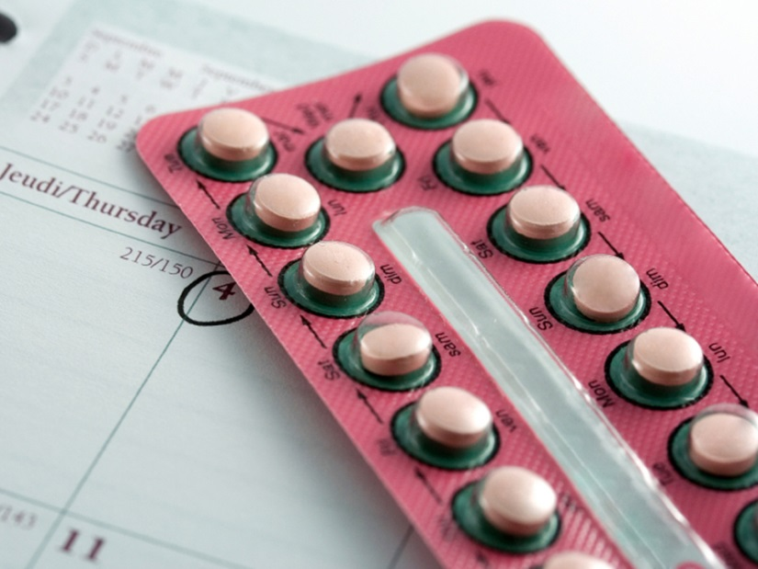
Intimate Partner Violence and Pregnancy
In addition to forced intercourse, behaviors that undermine women’s abilities to prevent unwanted pregnancy in abusive relationships include women’s lack of negotiating power to insist on contraceptive use and a number of other factors to be discussed shortly.

Slide 28

Intimate Partner Violence and Pregnancy
Pregnancy is a very vulnerable time for women in abusive relationships as the violence often begins or escalates during this time.
IPV in pregnant women is of great concern due to the associated increased risks of negative effects, including intrauterine growth retardation, perinatal death, miscarriage, low birth weight, preterm labor, delayed pre-term care, and homicide.

Slide 29

Intimate Partner Violence and Pregnancy
Sources of pregnancy-related increased risk for violence include the following:
1) Partner’s jealousy and resentment toward the child
2) Partner’s increased feelings of insecurity and/or possessiveness
3) Financial worries
4) Woman’s reduced physical and emotional availability during pregnancy
5) Partner’s desire to make a woman resolve the pregnancy the way that he prefers

Slide 30

Intimate Partner Violence and Pregnancy
Reproductive control occurs when women’s partners demand or enforce their own reproductive intentions whether in direct conflict with, or without interest in, the woman’s intentions.

Slide 31

Intimate Partner Violence and Pregnancy
Reproductive control can take numerous forms: economic, emotional, and physical.

Slide 32

Reproductive Control:
Before Pregnancy
Pregnancy Promotion
1) Pressuring and coercing a woman to become pregnant.
2) Stating intentions to impregnate a woman.
3) Pressuring a woman to become pregnant again immediately after a pregnancy loss.
4) Accusing her of being unfaithful if she wants to abstain from sex as a tactic to get to her to have sex.

Slide 33
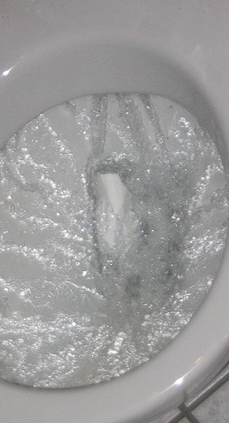
Reproductive Control:
Before Pregnancy
Contraceptive Sabotage
1) Flushing birth control pills down the toilet and searching for hidden birth control to destroy it
2) Refusing to withdraw (even if the agreed-upon contraception)
4) Refusing to help pay for birth control
5) Convincing a woman that birth control has dangerous side effects
6) Forcing sterilization

Slide 34
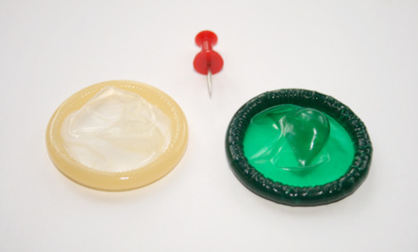
Reproductive Control:
During Intercourse
Sexual Violence
1) Forcing unprotected sex
2) Forcing sex after condom breaks
3) Unprotected sex with a woman while she is asleep
Condom Manipulation
1) Removing the condom during sex
2) Compromising the condom
3) Not putting the condom on, but saying he did
4) Refusing to use condoms

Slide 35

Women who have experienced intimate partner violence are consistently found to have poor sexual and reproductive health when compared to non-abused women. Coker (2007) reported that 74% of IPV victims experienced male reproductive control involving pregnancy-promoting behaviors as well as control and abuse during pregnancy in an attempt to influence the pregnancy outcome.

Slide 36

Intimate Partner Violence and Pregnancy
By assessing for male
reproductive control among
women seeking reproductive
health services, including
antenatal care, health care
providers may be able to
provide education, care, and
counseling to help women
protect their reproductive
health and physical safety.

Slide 37

Reproductive Control:
During Pregnancy
Controlling Pregnancy Outcome: Forced Abortion
1)Threatening to end a woman’s pregnancy violently if she did not have an abortion
2) Threatening to kill her or her loved ones if she doesn’t have an abortion
3) Perpetuating violence against her in order to cause a miscarriage or kill the fetus
4) Preventing access to prenatal care

Slide 38

Studies on the Incidence of IPV Among Women Seeking Abortion
In a cross-sectional cohort study by Woo and colleagues (2005), 14% of women seeking abortion (n=818) disclosed significant abuse within the past year.
Physical or sexual abuse or both was twice as common among women, who chose not to disclose the abortions to their partners (23.7% vs. 12.0%) compared to those who did. Among non-disclosers, 8% of women said that disclosure would result in physical harm.

Slide 39
Studies on the Incidence of IPV Among Women Seeking Abortion
In a meta-analysis published in early 2014, Hall and colleagues reported that rates of IPV among women seeking abortion services was up to 30%. In a narrative review by Williams and Brackley (2009) rates of abuse in abortion-seeking women were found to be between 24% and 39.5%. According to Pallitto and colleagues (2013), reducing intimate partner violence by 50% could potentially reduce unintended pregnancy by 2%–18% and abortion by 4.5%–40%. In this study of 17,518 women by Pallitto et al., utilizing data from the WHO Multi-Country study, the population attributable risk statistic revealed that 30% of abortions were directly related to IPV.

Slide 40

Studies on the Incidence of IPV Among Women Seeking Abortion
In a study by Weibe and Janssen (2001), the prevalence of domestic violence in the past 12 months was 15% among 254 women who were screened for domestic violence at an abortion clinic.
The women who were abused did not differ significantly from the non-abused women with respect to age, gestational age, or ethnicity (sample predominately Caucasian and Asian women).

Slide 41

Studies on the Incidence of IPV Among Women Seeking Abortion
Nearly all the women felt comfortable completing the questionnaire and thought it was good to ask questions about abuse. According to the authors: “This study has demonstrated that it is possible to ask women about family violence at an abortion clinic.”

Slide 42

Studies on the Incidence of IPV Among Women Seeking Abortion
In a high quality study by Fisher and colleagues (2005) published in the Canadian Medical Association Journal, the authors reported that women presenting for a third abortion were over 2.5 times more likely to have a history of physical or sexual violence than women presenting for their first.

Slide 43
Several peer-reviewed studies have shown that abusive partners are particularly inclined to coerce their partners to abort (Coggins & Bullock, 2003; Hathaway, Willis, Zimmer & Silverman, 2005; Thiel de Bocanegra, Rostovtseva, Khera, & Godhwani, 2010; Silverman, Decker, McCauley, Gupta, Miller, Raj & Goldberg, 2010).
For example, Silverman and colleagues (2010) reported the results of data on 1,318 men recruited from three large community health centers. The men were between the ages of 18 and 35. Partner conflict regarding abortion was more likely among abusive men compared to controls (19.8% versus 7.0%; ARR=2.80; 95% CI=2.06, 3.82), with the perpetration of intimate partner violence associated with men’s attempts to promote abortion (Relative risk: 2.41).

Slide 44
The Necessity and Nature of Effective IPV Screening Protocols
Efforts to Save Lives

Slide 45

Screening
The rationale for screening in medicine is somewhat related to the incidence of a certain condition or habit within a given population.
The incidence of commonly screened habits/conditions among pregnant women ages 15-45 include the following: tobacco use (27%), cervical cancer (0.008%), hypertension (8%), and glucose intolerance during pregnancy (1%-5%).
The incidence of IPV in the US is 21%, exceeding that of many of the conditions for which screening is routine.

Slide 46

Screening
Healthcare providers
need to be able to
recognize signs of
violence and respond
appropriately and safely.
Victims require comprehensive
services that address the
physical and mental health
consequences of trauma.

Slide 47

Screening
Health-care providers are likely to be
the first professional contact for
survivors of intimate partner
violence or sexual assault.
Victims actually use health-care
services more than non-victims.
Survivors of violence identify health-care
providers as the professionals they would
most trust with disclosure of abuse.

Slide 48
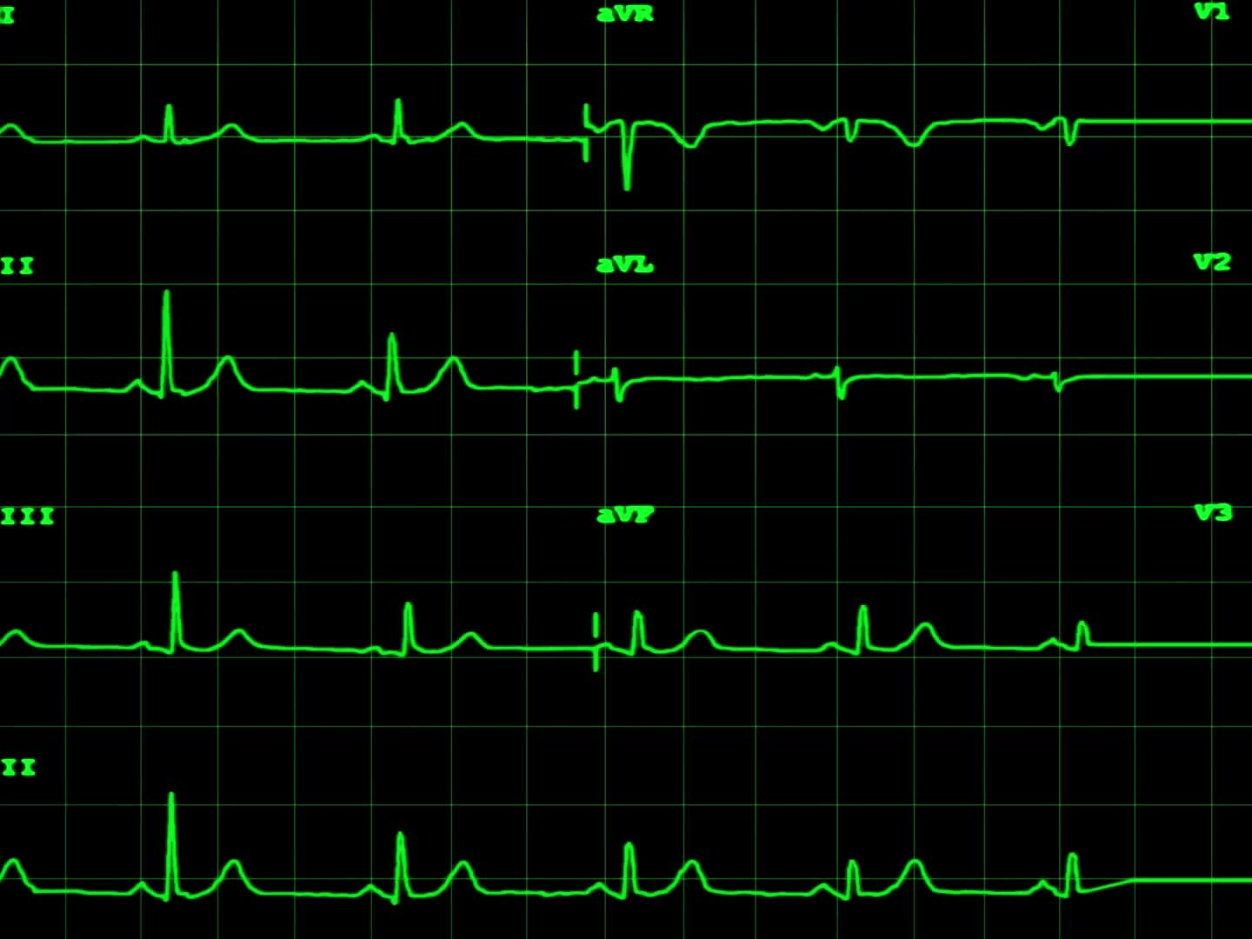
American Nursing Association (ANA) and
American Medical Association (AMA)
Policy H-515.965 on Family and Intimate Partner Violence
“To improve clinical services as well as the public health, the ANA and the AMA encourages providers to:
1. Routinely screen for IPV
2. Acknowledge the victim’s experience and assess the abuse for acute and chronic health effects.
3. Document the abuse through detailed charting, body maps and photos.
4. Assess the risk for future injury or lethality. It is important that before the patient leaves a risk assessment is preformed and that level of safety is ascertained.
5. Review options and Refer. Safety planning should be done with every patient with positive history of IPV before leaving the clinical setting.”

Slide 49
Numerous Well-Validated and Reliable Assessment Tools are Available to Evaluate Risk and the Need for Intervention...a few examples…

Slide 50

Validated Assessment Tools: SAFE
Ashur, M. (1993). Asking About Domestic Violence: SAFE Questions. JAMA, 269(18):2367SAFE Questions
Stress and safety: Do you feel safe in your relationship?
Afraid or Abused:
  Has your partner ever threatened you or your children?
  Has your partner ever abused you or your children?
Friends and Family:
  If you were hurt, would your friends or family know?
  Would they be able to help you?
Emergency Plan:
  Do you have a safe place to go in an emergency?
  Do you need help in locating a shelter?
  Would you like to talk to a counselor about this?

Slide 51

Validated Assessment Tools: Hurt Insult Threaten Scream (HITS)
How often does your partner?
1. Physically hurt you?
2. Insult or talk down to you?
3. Threaten you with harm?
4. Scream or curse at you?
Each item is scored from 1-5. Never (1) Rarely (2) Sometimes (3) Fairly often (4) Frequently (5). A score of greater than 10 is considered positive.

Slide 52

American Medical Association
Screening Questions
1. Are you in a relationship in which you have been physically hurt or threatened by your partner?
2. Are you in a relationship in which you felt you were treated badly? In what ways?
3. Has your partner ever destroyed things that you cared about?

Slide 53

American Medical Association
Screening Questions
4. Has your partner ever threatened or abused your children?
5. Has your partner ever forced you to have sex when you didn’t want to? Does he force you to engage in sex that makes you feel uncomfortable?
6. We all fight at home. What happens when you and your partner fight or disagree?
7. Do you ever feel afraid of your partner?

Slide 54

American Medical Association
Screening Questions
8. Has your partner ever prevented you from leaving the house, seeing friends, getting a job, orcontinuing your education?
9. You mentioned that your partner uses drugs/alcohol. How does he act when he is drinking or on drugs? Is he ever verbally or physically abusive?
10. Do you have guns in your home? Has your partner ever threatened to use them when he was angry?

Slide 55
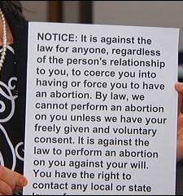
COERCION IS ILLEGAL
Forcing a woman to have an abortion, including a minor, is illegal in all 50 states of the United States of America.

Slide 56
Screening for Coercion to Abort
Asking a few basic questions may signi help women to avoid an unwanted abortion and many years of associated suffering:
Is someone else encouraging you to abort?
Is this your decision or are you seeking to please someone else by having an abortion?
Are you feeling pressured by anyone to abort?
Do you feel any desire to continue your pregnancy?

Slide 57
Conclusion
Routine screening for intimate partner violence in general, and coercion to abort in particular, are far from the norm.
Instead, abortion providers callously and routinely look the other way, even when women present with obvious symptoms of domestic violence.

Slide 58

Conclusion
Since the majority (67%–80%) of intimate partner homicides occur in the context of pre-existing physical abuse, identification and intervention with women at risk, particularly women seeking abortions, carries great potential to preserve women’s health and lives, while also empowering them to continue their pregnancies.

Slide 59
References
Cobia, D. C., Robinson, K., & Edwards, L. (2008). Intimate partner violence and women’s sexual health: Implications for couples therapists. The Family Journal, 16(3), 249-253.
Coggins, M., & Bullock, L. F. C. (2003). The wavering line in the sand: The effects of domestic violence and sexual coercion. Issues in Mental Health Nursing, 24(6-7), 723–738.
Coker A. L. (2007). Does physical intimate partner violence affect sexual health? A systematic review. Trauma, violence & abuse, 8(2), 149–177.
Fisher, W. A., Singh, S. S., Shuper, P. A., Carey, M. Otchet, F., MacLean-Brine, & D.,Gunter, J. (2005). Characteristics of women undergoing repeat induced abortion. Canadian Medical Association Journal, 172(5), 637-641
Hall, M., Chappell, L. C., Parnell, B. L., Seed, P. T., & Bewley, S. (2014). Associations between intimate partner violence and termination of pregnancy: a systematic review and meta-analysis. PLoS medicine, 11(1), e1001581.

Slide 60
Hathaway, J. E., Willis, G., Zimmer, B., & Silverman J. G. (2005). Impact of partner abuse on women’s reproductive lives. Journal of the American Medical Women’s Association, 60(1), 42-45.
Pallitto, C. C., Garcia-Moreno, C., Jansen, H. A., Heise, L., Ellsberg, M., & Watts, C. (2013). Intimate partner violence, abortion, and unintended pregnancy: Results from the WHO multi- country study on women's health and domestic violence. International Journal of Gynaecology and Obstetrics, 120(1), 3–9.
Stewart, D. E., MacMillan, H., & Kimber, M. (2021). Recognizing and Responding to Intimate Partner Violence: An Update. Canadian journal of psychiatry. Revue canadienne de psychiatrie, 66(1), 71–106.
Silverman, J. G., Decker, M. R., McCauley, H. L., Gupta, J., Miller, E., Raj, A. & Goldberg, A. B. (2010). Male perpetration of intimate partner violence and involvement in abortions and abortion-related conflict. American Journal of Public Health, 100(8), 1415-1417.

Slide 61
Thiel de Bocanegra, H., Rostovtseva, D. P., Khera, S., Godhwani, N. (2010). Birth control sabotage and forced sex: experiences reported by women in domestic violence shelters. Violence Against Women, 16(5), 601-612.
Wiebe, E. R., & Janssen, P. (2001). Universal screening for domestic violence in abortion. Women's health issues : official publication of the Jacobs Institute of Women's Health, 11(5), 436–441.
Williams, G. B. & Brackley, M.H. (2009) Intimate partner violence, pregnancy and the decision for abortion, Issues in Mental Health Nursing, 30:4, 272-278.
Woo, J., Fine, P., & Goetzl, L. (2005). Abortion disclosure and the association with domestic violence. Obstetrics and gynecology, 105(6), 1329–1334.

Slide 62

Where Science Meets Contemporary Reproductive Loss Needs

