Slide 1


Slide 2

Abortion Among Minor
Victims of
Sexual Abuse and
Sex Trafficking
Priscilla K. Coleman, PHD
International Institute for Reproductive Loss

Slide 3
Introduction
Acts of sexual abuse and sex trafficking against minors are widespread in the U.S. with devastating consequences. The egregious acts rob them of their most basic and essential needs for security and safety and launch a life trajectory marked by severe, often life-long suffering.
Pregnancies among sexually exploited youth frequently end in abortion and are often the result of coercion by the perpetrators. As such, abortion does not offer an escape for sexual abuse and trafficking victims but instead operates as a tool by abusers to maintain control and continue criminal activity.
Easing standards for access to abortion among minors is likely to make abuse even harder to detect and stop. The hidden nature of the crimes combined with ignorance, apathy, and complicit behavior by abortion providers, reveal an urgent need to intervene with this highly traumatized, vulnerable, and likely growing segment of our population.

Slide 4
Scope of the Problem of Sexual
Exploitation of Minors
In an extensive review of published studies, Townsend and Rheingold (2013) reported the prevalence of child sexual abuse for girls under age 18 in the U.S. is between 11% and 17%.
Other national studies have revealed 5% to 25% of adults report childhood sexual abuse, depending on the segment of the population studied and the definitions of sexual abuse employed.

Slide 5

Scope of the Problem of
Sexual Exploitation of Minors
Child sexual abuse by family members is widespread.
Approximately one-third of child sexual abuse is committed by family members.
Approximately 90% of victims know their abuser.

Slide 6
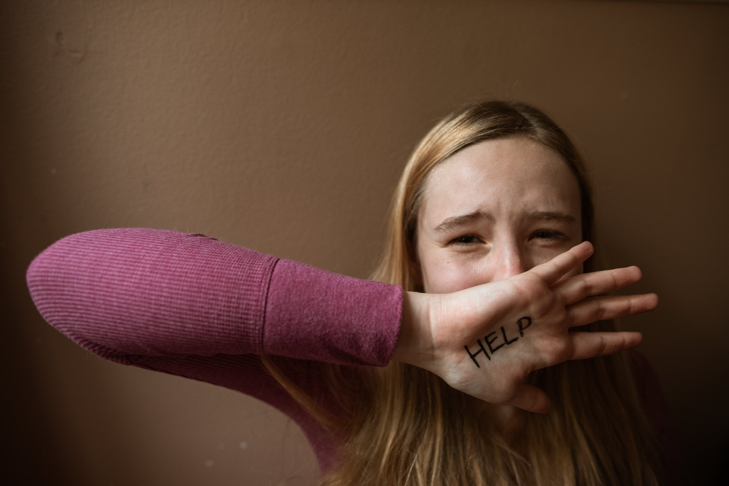
Scope of the Problem of Sexual Exploitation of Minors
Of the family cases, fathers and step-fathers are the most common type of relative.
On average, victims of child sexual abuse by relatives experience greater negative consequences compared to victims of sexual abuse committed by nonrelatives.

Slide 7

Scope of the Problem of Sexual
Exploitation of Minors
Sexual abuse is a social ill of epidemic proportions, affecting children of all ages, socioeconomic, and cultural backgrounds.
The World Health Organization (WHO) has defined childhood sexual abuse as the, “involvement of a child in sexual activity that he or she does not fully comprehend and is unable to give informed consent to.”
Sexual abuse has also been defined in the professional literature as “any sexual conduct or contact of an adult or significantly older child with or upon a child for the purposes of the sexual gratification of the perpetrator.”

Slide 8

Domestic Minor Sex Trafficking Defined
Domestic minor sex trafficking (DMST) is defined as the recruitment, harboring, transportation, provision, or obtaining of U.S. minors for the purposes of a commercial sex act (Trafficking Victims Protection Act)
Includes a person’s exchange or acceptance of sex acts to meet basic needs such as for food and shelter, also termed survival sex.
The giving or receiving of anything of value (e.g. money, clothing, shelter) or the commercial elements are what differentiates DMST from other forms of sexual exploitation, such as sexual assault or rape.

Slide 9
How widespread is Sex Trafficking of Minors?
Cases of sex trafficking have been identified in all 50 states using arrest records, with available data indicating trafficking is thriving in every region, state, and community within the United States.
One study revealed that over 60% of identified human trafficking cases in the U.S. involve citizens, and nearly one-third (32%) are minors (Kyckelhahn, Beck, & Cohen, 2009).

Slide 10
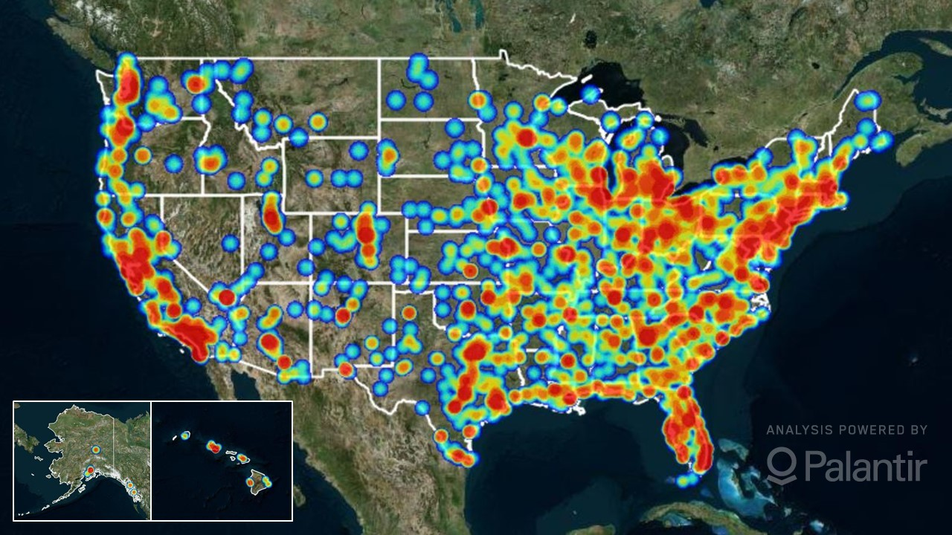
Locations of likely human trafficking cases in the United States in 2018.

Slide 11
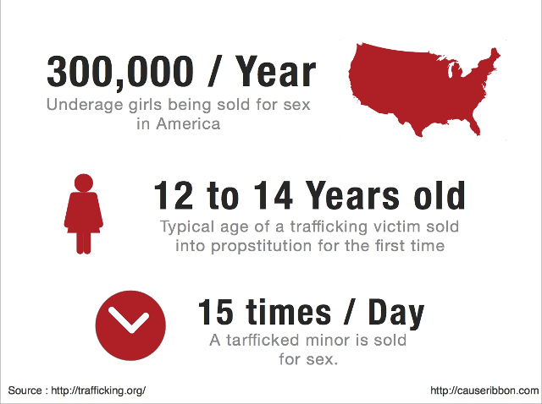
How widespread is Sex Trafficking of Minors?
The majority of female sex trafficking victims in the U.S are recruited between the ages of 12 and 14.
The most widely cited statistics suggest that 300,000–400,000 children are at risk or become victims of sex trafficking in the U.S. each year.
However, many believe more accurate numbers are in the millions and the cited figures are likely underestimated due to study limitations and many other factors.

Slide 12

Emotional and Physical Damage to
Sexually Exploited Minors

Slide 13

Emotional and Physical Damage to Sexually Exploited Minors…Focus on Sexual Abuse
Child sexual abuse is associated with a wide range of emotional and physical health adversities.
Martin, et al. (2004) reported that the incidence of psychiatric diagnoses occurring over a lifetime is 56% for women who have disclosed a history of child sexual abuse.
Increased risks for depression, suicidal ideation and behaviors, substance abuse, and PTSD have been consistently associated with sexual abuse exposure.

Slide 14

Psychological Damage to Sexually Exploited Minors…Focus on Sexual Abuse
Borderline Personality Disorder, Dissociative Identity Disorder, and eating disorders are more common with child sexual abuse, as are pain disorders.
A history of sexual abuse also places a child at increased risk for sexual re-victimization in adolescence and adulthood, especially among females.

Slide 15
Childhood Abuse Histories Common Among Victims of Sex Trafficking
Several studies have demonstrated high rates of sexual abuse (90-95%) prior to sex trafficking exploitation.
Cole (2018) reported that minors who are exploited in commercial sex often have histories of neglect and abuse, highly conflicted relationships with family, and unstable home environments.
Youth who are trafficked typically struggle with various physical, emotional, and behavioral symptoms associated with complex trauma, involving a chronic state of vigilance and perception of adults as sources of threat rather than of comfort or support.
These young people may experience difficulties in a range of domains, including attachment, behavioral self-control, self-concept, and emotional regulation, among others.

Slide 16

Psychological Damage to Sexually Exploited Minors…Focus on Trafficking
The most common mental health conditions include substance use disorders, Post-Traumatic Stress Disorder, depression and suicidality, and anxiety.

Slide 17
Comprehensive list of Adverse Effects of Sex Trafficking
Adverse mental health consequences: damaged sense of self, shame, severe stigma, hopelessness, compromised interpersonal boundaries, distrust of others, anxiety disorders, pathologic fear, panic attacks, sleep disturbances, depression, substance abuse, suicidal thoughts and behaviors, and dissociative disorders.
Some victims develop trauma-like symptoms similar to those experienced by survivors of torture. The effects of human trafficking can cause victims to be unable to develop adaptive coping skills, and long-term healthy relationships.
These long-term negative effects leave them with serious attachment problems, social isolation, and susceptible to re-victimization.

Slide 18
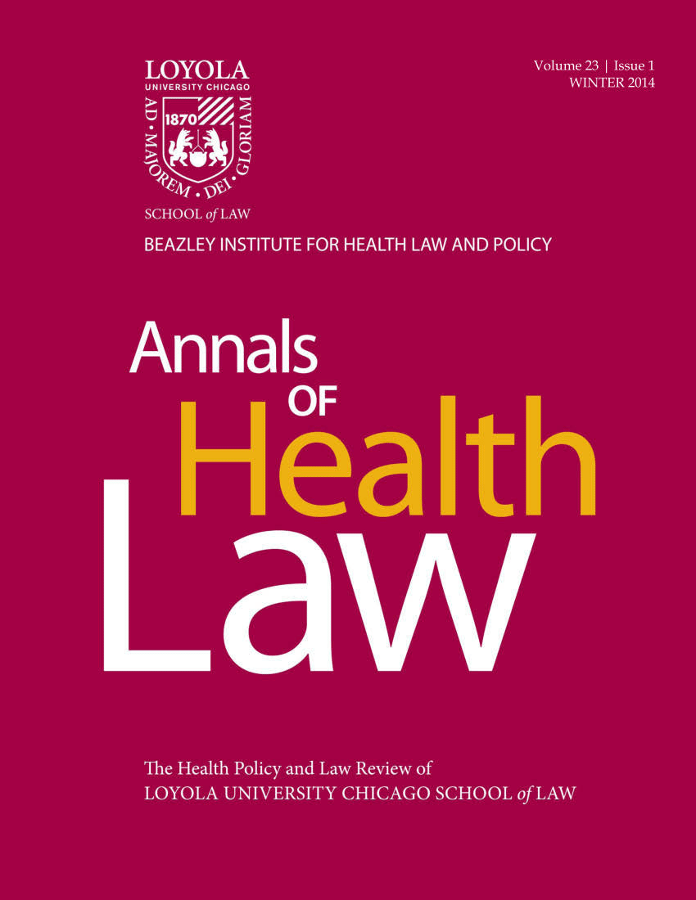
Lederer and Wetzel (2014) Study of Over 100 Domestic Sex Trafficking Victims and Survivors
On average, the respondents reported being used for sex by approximately 13 buyers per day. Some respondents reported typical days of as many as 30-50 buyers.
The authors addressed the devastating consequences of trafficking, demonstrating injuries, illnesses, and impairments often continue for decades.
They noted the healthcare system is failing trafficked victims, health care providers of all kinds are seeing trafficking victims, but failing to identify them, effectively enabling the criminal behavior and exacerbating the profoundly disabling problems victims incur.

Slide 19
Lederer and Wetzel (2014) Study
The most frequently reported psychological problems were depression (89%), anxiety (76%), nightmares (74%), flashbacks (68%), low self-esteem (81%), and feelings of shame or guilt (82%). A substantial number of survivors suffered from other psychological disorders, including Acute Stress (39%), Bipolar (30%), Depersonalization (20%), Multiple Personality (13%), and Borderline Personality (13%) Disorders.
Alarmingly, 41% had attempted suicide (one victim reported 9 attempts) and 55% suffered from Post-Traumatic Stress Disorder. Escape from trafficking was far from a remedy for the psychological suffering of survivors. After trafficking, 96% of survivors reported at least one psychological symptom with an average of 10.5 symptoms across the sample.
The authors commented that the, “picture painted by these surveys and the personal interviews that accompanied many of them is one of complete mental devastation.”

Slide 20

Lederer and Wetzel (2014) Study
Many survivors were dependent on drugs or alcohol while they were trafficked, either because the substances were forced (28%) on them as a means of control or because substances operated as a form of coping.
The vast majority (84%) used alcohol, drugs, or both during trafficking.
More than a quarter of the respondents reported injecting drugs (27%) and experiencing overdoses (26%).
Alcohol, marijuana, and cocaine were the most common substances (used by over 50%).

Slide 21
Pregnancy Among Victimized Youth
Studies indicate as many as 50% to 66% of pregnant adolescents have a history of childhood sexual or physical abuse (AGI, 1994; Sexuality Information, 1995; Klein, 2005).
In a comprehensive meta-analytic review of 21 studies addressing the association between childhood sexual abuse and adolescent pregnancy, Noll and colleagues (2009) reported over a two-fold increase in the odds of experiencing an adolescent pregnancy when prior sexual abuse had occurred.
A study by Fortin-Langelier and colleagues (2019) was the first matched cohort study assessing the risk of pregnancy and related complications in an adolescent population with corroborated sexual abuse reports. Participants with a history of childhood sexual abuse were at heightened risk of pregnancy.

Slide 22
Pregnancy Among Victimized Youth
Adolescent females in relationships with adult men are more likely to have intercourse at a younger age and have increased rates of pregnancies, even after accounting for a range of associated psychosocial risk factors such as problem drinking, drug use, difficulty in school, and delinquency (Child Trends, 2012; Miller, Clark, & Moore, 1997; Young & d’Arcy, 2005).
Involvement in sexually exploitative relationships with older male partners are often coercive with detrimental psychological consequences for the girls involved (Darroch, Landry, & Oslak, 1999; Teare & English, 2002; Leitenberg & Saltzman, 2000; Lindberg, Sonenstein, Ku, & Martinez, 1997).

Slide 23

Abortion Among Sexually Exploited Youth
Due to the nature of crimes against sexually exploited adolescents, such victims often present for abortions against their will and in desperate need of intervention to end the victimization.

Slide 24

Abortion Among Sexually Exploited Youth
The experience of childhood sexual abuse is related to increased risks of undergoing abortion in adolescence and early adulthood.
Wingood and DiClemente (1997) found that women who had been sexually abused in childhood were 1.5 times more likely to have had an abortion.
Bourassa and Berube (2007) reported that women who chose to have an abortion were more likely to have been exposed to childhood sexual abuse compared to women continuing with pregnancy.
Likewise, Russo and Denious (1998, 2001), using data from a large cross-sectional study of women, found that women who had undergone an abortion were more likely to have been exposed to childhood sexual abuse than women who had not had an abortion.

Slide 25
Abortion Among Sexually Exploited Youth
Forced abortion among adolescents victimized by sex trafficking has been well-documented (Abdulraheem & Oladipo, 2010; Diep, 2006; Hoyle, Bosworth, & Dempsey, 2011; Lederer & Wetzel, 2014; Zimmerman, Hossain & Watts, 2011).
Women trafficked are often subjected to multiple abortions (Cwikel, Chudakov, Paikin, Agmon, & Belmaker, 2004; U.S. Justice Department, n.d.).
Egregiously, some women are forced to abort during late pregnancy and to resume sex work only days later (Getu, 2006). A 2011 report of the American Psychological Association (APA, 2013) acknowledged a need for research on the long-term effects of forced abortions on survivors’ sexual and reproductive health.

Slide 26
Abortion Among Sexually Exploited Youth
In a U.S. cross-sectional study of sex trafficked victims by Muftic and Finn (2013), 58% became pregnant while being trafficked.
In Lederer and Wetzel’s (2014) study, 71.2% of victims had at least one pregnancy while being trafficked and 21.2% reported five or more pregnancies. Further, more than half of the victims (55.2%) reported at least one abortion and 29.9% reported multiple abortions.
In Lederer and Wetzel’s study, 52.9% of the sex trafficked victims indicated that one or more of their abortions was at least partly forced. One survivor, whose abuse at the hands of her traffickers was particularly deplorable, reported 17 abortions and indicated that at least some of them were forced. The authors commented that forced abortion violates both the pro-life belief that abortion takes innocent life and the pro-choice ideal of women’s freedom to make their own reproductive decisions.

Slide 27
Abortion Among Sexually Exploited Youth
Abortion providers frequently have contact with individuals trapped in abhorrent trafficking situations. Available evidence described by Lederer and Wetzel suggests that not only do abortion providers fail to routinely screen for trafficking and other forms of sexual abuse and exploitation, but they often actively ignore signs that women are in harmful situations.
Lederer and Wetzel noted that the survivors had, “significant contact with clinical treatment facilities, most commonly Planned Parenthood.” When asked why they went to Planned Parenthood, one survivor said, “because they didn’t ask any questions.”

Slide 28

Abortion Among Sexually Exploited Youth
In an edited book titled, “Human Trafficking is a Public Health Issue” (Chisolm-Straker & Stoklosa, 2017), one author is Wendy J. Barnes, an outspoken human trafficking survivor and advocate. Trafficked for over 13 years, she describes experiences at abortion clinics wherein the doctors and nurses provided minimal attention, devoid of any interest or assistance:
“In my late teens, I had two abortions at a private clinic. Nobody—neither the nurses nor the doctors—ever asked me if I really wanted the abortion. Nobody asked me if it was a trick baby. I had three or four more abortions at nonprofit community clinics. All of them were the same as any other doctor visit. The nurse prepared me, and the doctor came in, ‘fixed’ the problem, and left.” (p. 20).

Slide 29
Abortion Among Sexually Exploited Youth
Several court cases have involved abortion providers ignoring clear indications that minors are in abusive situations.
The story of Ohio resident Denise Fairbanks was described in the Toledo Blade in 2007. She was sexually abused by her father beginning at age 13 and forced to sleep with him every night. Pregnant at age 16, he forced her to have an abortion. Seeing an opportunity to escape the horrific abuse, Denise told the staff, but instead of helping her out of the egregious situation, they ignored her, violating Ohio’s mandatory reporting law. According to the lawsuit she filed against Planned Parenthood three years later (Fairbanks v. Planned Parenthood Southwest Ohio Region, Court of Common Pleas, Civil Division, Hamilton County, Ohio, Case No. A0901484), Denise was sent back to the same abusive situation, where she remained for another year-and-a-half. Subsequently Denise’s basketball coach found out about the abuse and filed a report with authorities, leading to her father’s prosecution.

Slide 30
Abortion Among Sexually Exploited Youth
In another highly publicized case in Colorado, described in 2015 in the Washington Times, Timothy David Smith had sexually abused his stepdaughter for 7 years. When she was pregnant at 13 years old, he brought her to a clinic to undergo an abortion. Afterwards she was sent back home with Smith, and he continued to rape and abuse her. The victim told her mother months later while Smith was not home. According to the 2014 lawsuit that the mother initiated (Cary Smith (Sisk) v. Planned Parenthood of the Rocky Mountains, et al., Denver District Court, Case No. 2014 CV 21778), the facility performed the abortion without notifying the child’s parents and without reporting the suspected abuse, as required by Colorado law. According to the case documents, not a single staffer of the four with whom the child interacted asked her about the circumstances of the pregnancy. One employee admitted in a deposition that to them, “being 13 and pregnant alone is not a red flag” of possible abuse.

Slide 31
Abortion Among Sexually Exploited Youth
In a third case, Joseph Coles sexually abused the daughter of his girlfriend for several years in Ohio, beginning when she was only ten-years-old. She had two pregnancies aborted (the first occurred at age 12). The family moved to Iowa, and the girl told her mother of the abuse and the abortions. Neither abortion facility reported the statutory rape to law enforcement. A criminal investigation was conducted once the girl told her mother (State of Ohio v. Joseph Coles, Cuyahoga County Court of Common Pleas, Case No. CR-478823).

Slide 32
Abortion Among Sexually Exploited Youth
Finally, in a fourth highly publicized case, for which Dr. Coleman served as an expert witness, a 13-year-old girl was impregnated by her 21-year-old soccer coach, John Haller (Roe v. Planned Parenthood Southeast Region of Ohio, Court of Common Pleas, Civil Division, Hamilton County, Ohio, Case No. A0502691). To conceal the statutory rape, Mr. Haller arranged for an abortion by impersonating her father during a telephone call with the abortion clinic and then pretended to be her brother while at the clinic. The coach resumed having sex with Roe after the abortion. As a result of a subsequent report made by a teacher, the coach was later found guilty of 7 counts of sexual battery. The girl and her parents sued the clinic for failure to comply with the Ohio sexual abuse reporting statute.
When abortion providers look the other way and fail to report the sexual exploitation of minors, they are complicit in the abuse. Failure to intervene results in perpetuation of a form of victimization linked to a wide array of adverse psychological and physical health outcomes both during adolescence and into adulthood.

Slide 33

Conclusion
Egregious acts of sexual exploitation against minors rob them of their most basic and essential needs for security and safety and launch a life trajectory marked by severe, often life-long suffering frequently exacerbated by forced abortion. The hidden nature of the crimes combined with ignorance and apathetic behavior by health care professionals, necessitates laws designed to intervene with this highly traumatized, vulnerable, and growing segment of our population.

Slide 34
Abdulraheem, S. & Oladipo, A.R. (2010). Trafficking in women and children: A hidden health and social problem in Nigeria. International Journal of Sociology and Anthropology, 2(3), 034-039. Retrieved from http://www.academicjournals.org/app/webroot/article/article1379417352_Abdulraheem%20and%20Ola dipo.pdf
Alan Guttmacher Institute (AGI) (1994). Sex and America’s teenagers. New York, NY: Alan Guttmacher Institute.
American Psychological Association. (2013). Report of the taskforce on trafficking of women and girls. Washington, DC.
Bourassa, D., & Bérubé, J. (2007). The prevalence of intimate partner violence among women and teenagers seeking abortion compared with those continuing pregnancy. Journal of Obstetrics and Gynaecology Canada, 29(5), 415–423. doi: 10.1016/S1701-2163(16)35493-7.
Child Trends. (2012). Statutory rape: Sex between young teens and older individuals. Bethesda, MD.
Chisolm-Straker, M. & Stoklosa, H. (Eds). (2017). Human trafficking is a public health issue: A paradigm expansion in the United States. Springer International Publishing.
Cole, J. (2018). Service Providers’ Perspectives on Sex Trafficking of Male Minors: Comparing Background and Trafficking Situations of Male and Female Victims. Child and Adolescent Social Work Journal, 1-11.
Cwikel, J., Chudakov, B., Paikin, M., Agmon, K., & Belmaker, R. H. (2004). Trafficked female sex workers awaiting deportation: Comparison with brothel workers. Archives of Women’s Mental Health, 7(4), 243-249. doi: 10.1007/s00737-004-0062-8.

Slide 35
Diep, H. (2006). We pay - The economic manipulation of international and domestic laws to sustain sex trafficking. Loyola University Chicago International Law Review, 1(2), 309-331. Retrieved from https://lawecommons.luc.edu/cgi/viewcontent.cgi?article=1136&context=lucilr.
Diedrich, J. & Steinauer, J. (2009). Complications of surgical abortion. Clinical Obstetrics and Gynecology, 52 (2), 205-212.
Fortin-Langelier, E., Daigneault, I., Achim, J., Vézina-Gagnon, P., Guérin, V., & Frappier, J. Y. (2019). A matched cohort study of the association between childhood sexual abuse and teenage pregnancy. Journal of Adolescent Health, 65(3), 384-389. doi: 10.1016/j.jadohealth.2019.03.001
Getu, M. (2006). Human trafficking and development: The role of microfinance. transformation: An International Journal of Holistic Mission Studies, 23(3), 142-156. doi: 10.1177/026537880602300303
Hoyle, C., Bosworth, M. & Dempsey, M. (2011). Labelling the victims of sex trafficking: Exploring the borderland between rhetoric and reality. Social and Legal Studies, 20(3), 313-329. doi: 10.1177/0964663911405394.
Klein, J. D., & American Academy of Pediatrics Committee on Adolescence (2005). Adolescent pregnancy: Current trends and issues. Pediatrics, 116(1) 281-286. doi: 10.1542/peds.
Kyckelhahn, T., Beck, A., and Cohen, T. (2009). Characteristics of suspected human trafficking incidents 2007–2008 (Bureau of Justice Statistics Special Report). Washington, D.C.: U.S. Department of Justice. Retrieved from http://files.meetup.com/1160329/POST_on_Site.pdf (PDF, 188KB)

Slide 36
Lederer, L. J., & Wetzel, C. A. (2014). The health consequences of sex trafficking and their implications for identifying victims in healthcare facilities. Annals of Health Law, (1), 61-91. Retrieved from https://www.icmec.org/wp-content/uploads/2015/10/Health-Consequences-of-Sex-Trafficking- and-Implications-for-Identifying-Victims-Lederer.pdf
Leitenberg, H., & Saltzman, H. (2000). A statewide survey of age at first intercourse for adolescent females and age of their male partners: Relation to other risk behaviors and statutory rape implications. Archives of Sexual Behavior, 29(3), 203–215. doi: 10.1023/A:1001920212732
Lindberg, L. D., Sonenstein, F. L., Ku, L., & Martinez, G. (1997). Age differences between minors who give birth and their adult partners. Family Planning Perspectives, 29(2), 61–66. doi: 10.2307/2953363
Miller, K. S., Clark, L. F., & Moore, J. S. (1997). Sexual initiation with older male partners and subsequent HIV risk behavior among female adolescents. Family Planning Perspectives, 29(5), 212– 214. doi: 10.2307/2953397.
Noll, J. G., Shenk, C. E., & Putnam, K. T. (2009). Childhood sexual abuse and adolescent pregnancy: A meta-analytic update. Journal of Pediatric Psychology, 34(4), 366–378. doi: 10.1093/jpepsy/jsn098
Russo, N. F., & Denious, J. E. (1998). Understanding the relationship of violence against women to unwanted pregnancy and its resolution. In L. Beckman, & M. Harvey (Eds.), The new civil war: The psychology, culture, and politics of abortion (pp. 211-234). Washington, DC: American Psychological Association.

Slide 37
Russo, N. F., & Denious, J. E. (2001). Violence in the lives of women having abortions: Implications for practice and public policy. Professional Psychology: Research and Practice, 32(2), 142- 150. doi: 10.1037/0735-7028.32.2.142.
Sexuality Information and Education Council of the United States. (1995). Facing facts: Sexual health for America’s adolescents: The report of the National Commission on adolescent sexual health. New York, NY: Haffner, D. W.
Teare, C., & English, A. (2002). Nursing practice and statutory rape. Effects of reporting and enforcement on access to care for adolescents. The Nursing Clinics of North America, 37(3), 393-404. doi: 10. 1016/S0029-6465(02)00015-4.
Townsend, C. & Rheingold, A.A. (2013). Estimating a child sexual abuse prevalence rate for practitioners: A review of child sexual abuse prevalence studies. Charleston, S.C., Darkness to Light. Retrieved from www.D2L.org/1in10.
U.S. Department of Justice, National Institute of Justice. (2012). Full Report of the Prevalence, Incidence, and Consequences of Violence against Women: Findings from the National Violence Against Women Survey. Washington, DC.
Wingood, G. M., & DiClemente, R. J. (1997). Child sexual abuse, HIV sexual risk, and gender relations of African-American women. American Journal of Preventive Medicine, 13(5), 380-384.

Slide 38

Where Science Meets Contemporary Reproductive Loss Needs

